Slide 1

Interest Rate Statistics
of Other Depository Corporations
(Banks and Savings Houses)
- Adjustment of the Interest Rate Statistics to the European Requirements -
Statistics Department
Monetary Statistics Division
February, 2015
Notes:
.

Slide 2
Improvement of the Interest Rate Statistics
Adjustment to the Regulation ECB - ECB/2009/7 that relates to the Interest Rate Statistics.
Additional breakdowns that will provide harmonized data and facilitate comparability with data from other European countries.
More analytical data on sector, maturity, periods of initial rate fixation, breakdown by currency and purpose of the loans, for monitoring and analysis of movements in Interest Rates in the Republic of Macedonia, especially in new business on loans and deposits.
Greater scope by including savings houses as reporting entities.
Notes:
.

Slide 3
Reporting requirements of the ECB
Breakdown by: | Old reporting | New reporting
Reporting institutions: | Banks | Banks and savings houses
Sector: | Households (Individuals and self-employed individuals) Non-financial corporations (public and other) | Households (Individuals and self-employed individuals) Non-profit institutions serving households Non-financial corporations (public and other)
Business coverage: | Outstanding amounts (OA) New business (NB) | Outstanding amounts (OA) New business (NB)
Maturity: | Original maturity of loans / deposits | Original maturity of loans / deposits The initial period of fixation of interest rates Period of notice (NB- deposits)
Purpose of loans to households: | / | Consumer loans Loans for house purchase Loans for other purposes
Amount of loans to non-financial corporations: | / | up to EUR 0.25 million (NB) over EUR 0.25 million up to EUR 1 million (NB) over EUR 1 million (NB)
Currency: | in denars without foreign currency clause in denars with foreign currency clause in foreign currency (in EUR and US dollars) | in denars without foreign currency clause in denars with foreign currency clause in foreign currency (in EUR, US dollars, CHF and other currencies)
Collateralized loans: | / | Collateralized (NB)
Special instruments: | Overdrafts Credit cards Current accounts | Overdrafts, Revolving loans (NB), Credit cards Overnight deposits, (NB)

Slide 4
Reporting requirements of the ECB
Breakdown by: | Loans: Old methodology | New methodology | Deposits: Old methodology | New methodology
1. Original maturity | short term long term | up to 1 year, over 1 year up to 5 years and over 5 years; | up to 1 month over 1 month up to 3 months over 3 months up to 12 months over 1 year | up to 1 year, over 1 year up to 2 years and over 2 years;
2. Initial period of fixation of interest rates: | / | 1. Loans for house purchase, granted to households: floating rate or up to 1 year period of initial rate fixation over 1 and up to 5 years period of initial rate fixation over 5 and up to 10 years period of initial rate fixation over 10 years period of initial rate fixation 2. Consumer loans and loans for other purposes, granted to households: Floating rate or up to 1 year period of initial rate fixation over 1 and up to 5 years period of initial rate fixation over 5 years period of initial rate fixation 3. Loans granted to non-financial corporations: floating rate or up to 3 months period of initial rate fixation over 3 months and up to 1 year period of initial rate fixation over 1 year and up to 3 years period of initial rate fixation over 3 years and up to 5 years period of initial rate fixation over 5 years and up to 10 years period of initial rate fixation over 10 years period of initial rate fixation

Slide 5
New disseminated reports
Weighted interest rates’ reports:
Report KS1: WEIGHTED INTEREST RATES ON GRANTED LOANS AND RECEIVED DEPOSITS, outstanding amounts;
Report KS2: WEIGHTED INTEREST RATES ON GRANTED LOANS AND RECEIVED DEPOSITS, new business;
Report KS3: WEIGHTED INTEREST RATES ON NEWLY GRANTED LOANS WITH COLLATERAL;
Report KS4: WEIGHTED INTEREST RATES ON NEWLY GRANTED LONG-TERM LOANS, total and with collateral;
Report KS5: WEIGHTED INTEREST RATES ON OVERNIGHT DEPOSITS, REVOLVING LOANS, OVERDRAFTS, AND CREDIT CARDS CREDIT;
Report KS9: Time series of WEIGHTED INTEREST RATES ON OUTSTANDING AMOUNTS ON GRANTED LOANS AND RECEIVED DEPOSITS; and
Report KS10: Time series of WEIGHTED INTEREST RATES ON NEWLY GRANTED LOANS AND NEWLY RECEIVED DEPOSITS.
Reports from KS1 to KS5 are consisted of three parts:
Part I: Interest rates on loans/deposits, in denars without a foreign currency clause;
Part II: Interest rates on loans/deposits, in denars with a foreign currency clause;
Part III: Interest rates on loans/deposits, in foreign currency.

Slide 6
Applied concept for new business and total outstanding amounts
New business include all new agreements on loans/deposits between households/non-financial corporations and the Other Depository Corporations;
Interest rates reflects the weighted average interest rates applied to the new agreements of deposits/loans during the time reference period;
Interest rates on loans are divided according to: initial period of fixation, loans with and without collateral, and the amount of loans;
Interest rates on deposits are divided by original maturity or by the period of notice.
The amounts of new business are not equal with the reported balance sheets’ amounts.
2. Outstanding amounts are equal with the reported balance sheets’ amounts, except for those categories that are not reported as a special category in the balance sheet (repurchase agreements, deposits redeemable at notice, revolving loans and credit card credits)
Interest rates reflects weighted average interest rates applied to the stocks of loans/deposits on the last day of the time reference period;
All interest rates are divided according to the original maturity of the loans/deposits.

Slide 7
New reporting
а.
New business
Old reporting
All financial contracts, that specify for the first time the interest rate of deposits/loans and all new negotiations of existing deposits/loans.
Bad loans and loans for debt restructuring with agreed interest rates below market conditions, are not collected;
Prolongations of existing deposits/loans contracts that are carried out automatically, are not reported;
-All new business on loans/deposits, that are covered in book keeping as a funds’ incomes or outcomes, during the time reference period.
All loans for debt restructuring and
Prolongations of existing deposits/loans contracts that are carried out automatically.
b.
Outstanding amounts
No methodological differences between the old and the new reporting

Slide 8
Differences between the new and old methodology data
Greater scope: including savings houses as reporting entities, non-profit institutions serving households, as well as more detail breakdown by currencies (EUR, US dollars, CHF and other currencies).
2. Outstanding amounts:
For the category loans:
- New financial instrument financial leasing.
For the category deposits:
- sight deposits and overnight deposits are not included in the Interest Rate Statistics for outstanding amounts, but they are included in a separate report KS5 for overnight deposits, revolving loans, overdrafts and credit cards credits.
- there is a slight increase/decrease of the interest rates due to the changes of maturity breakdown’ margins.
Revolving loans are shown as a separate category in the report KS5, and they are excluded from Interest Rate Statistics for outstanding amounts.

Slide 9
Differences between the new and old methodology data
3. New business
on loans:
new financial instrument financial leasing
different methodological treatment of the bad loans and loans for debt restructuring (which are no longer reported), and
All financial contracts, that specify for the first time the interest rate of deposits/loans and all new negotiations of existing deposits/loans are reported, instead of financial contracts that were covered in book keeping as a funds’ incomes or outcomes, during the time reference period.
For the category deposits:
- sight deposits and overnight deposits are not included in the Interest Rate Statistics for outstanding amounts, and they are included in a separate report KS5 for overnight deposits, revolving loans, overdrafts and credit cards credits.
- there is slight increase/decrease of the interest rates due to the changes of maturity breakdown’ margins.
Prolongations of existing deposits/loans contracts that are carried out automatically, are not reported.

Slide 10
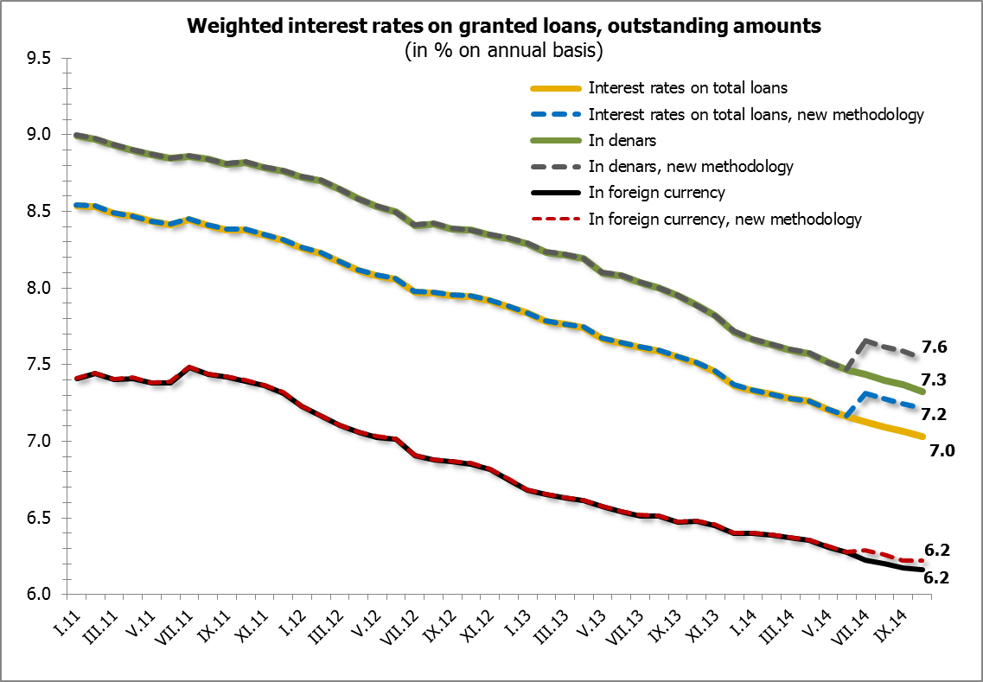

Slide 11
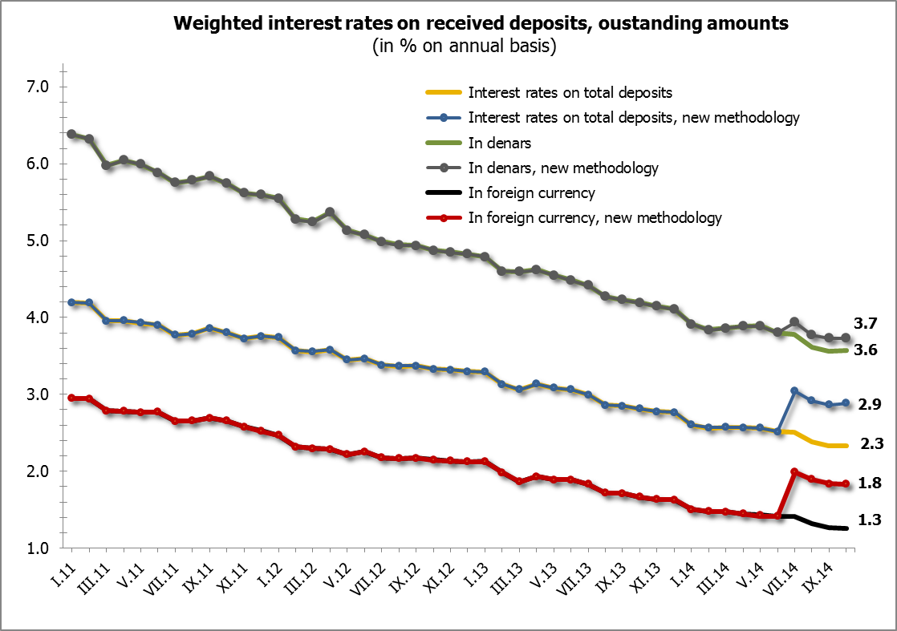

Slide 12
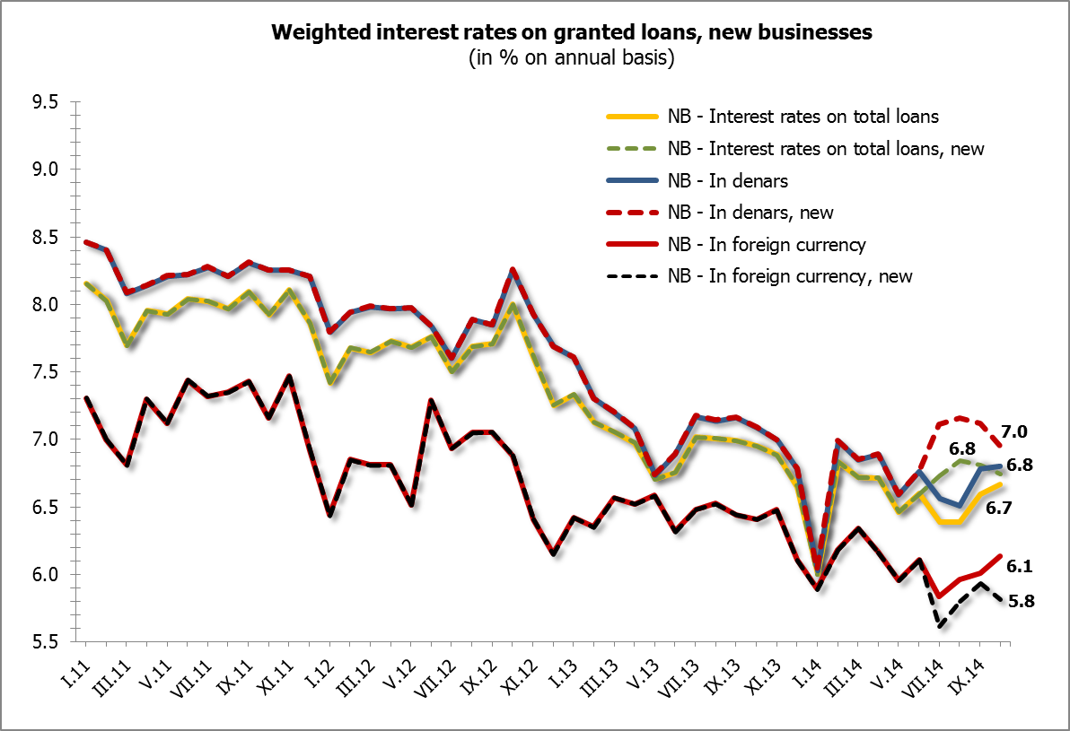

Slide 13
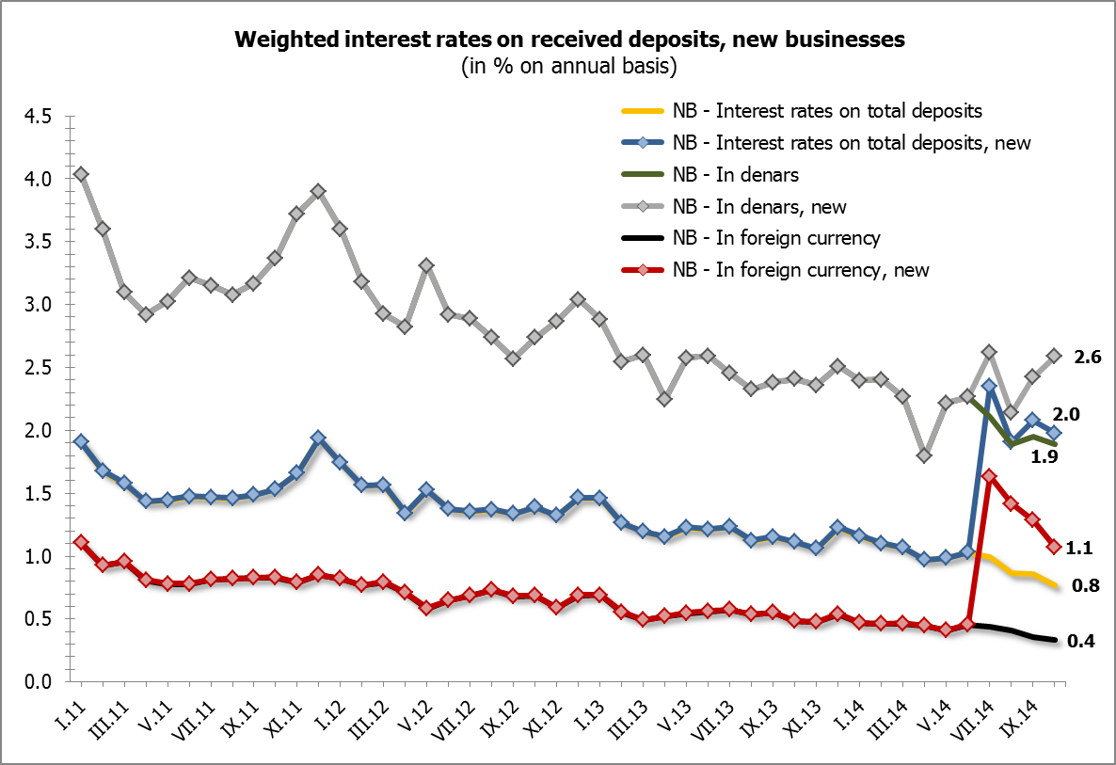

Slide 14
On February 27th 2015, Other Depository Corporations ‘Interest Rates on outstanding amounts and new business, based on the new methodology, are officially published on NBRM website, with data starting from January 2015.
Interest rates’ time series are also published, with data for outstanding amounts from January 2005, and for new business from December 2005.

