Slide 1
Measuring the Real Effective Exchange Rate Experience of Turkey
Serdar ERKILIÇ
Central Bank of the Republic of Turkey
Statistics Department / Balance of Payments Division
Joint NBRM & ECB Seminar on Statistics
2-5 October 2013, Skopje

Slide 2

Contents
References
Real Effective Exchange Rate Methodology
Turkey’s REER (2003-2013)

Slide 3
References
Saygılı, H., Saygılı, M. and Yılmaz, G. (2010). Türkiye için Yeni Reel Efektif Döviz Kuru Endeksleri (New Real Effective Exchange Rate Indexes for Turkey). CBT Working Paper No: 10/12. http://www.tcmb.gov.tr/research/discus/2010/WP1012.pdf
Saygılı, H., Saygılı, M. and Yılmaz, G. (2010). Yeni Endekslerle 2003-2010 Dönemi Reel Efektif Döviz Kuru Gelişmelerine İlişkin Gözlemler (Observations with New Indexes on 2003-2010 Period Real Effective Exchange Rate Developments). Research Notes in Economics, CBT, Ankara.
Yılmaz, G. and Gönenç, R. (2008). How did the Turkish Industry Respond to Increased Competitive Pressures, 1998-2007? Working Paper, CBT, Ankara.
Saygılı, M., Şahinbeyoğlu G. and Özbay, P. (1998). Competitiveness Indicators and the Equilibrium Real Exchange Rate Dynamics in Turkey", in Macroeconomic Analysis of Turkey: Essays on Current Issues. Working Paper, CBT, Ankara.
Kıpıcı, A.N. and Kesriyeli , M. (1997). Reel Döviz Kuru Tanımları ve Hesaplama Yöntemleri (Real Exchange Rate Definitions and Calculation Methods). Working Paper, CBT, Ankara.

Slide 4

Methodology-1
REER released by the Central Bank of Turkey (CBT), is computed as the weighted geometric average of the prices in Turkey relative to the prices of its principal trade partners in international markets. The real effective exchange rate can be formulated as follows:
where,
w_{i}, is country i’s weight in Turkey’s REER index
P_{TUR}, is the price index in Turkey
P_{i}, is the price index in country i
e_{i},TUR, is the nominal exchange rate of country i in terms of Turkish Lira (TL)
N, is the number of countries included in the analysis
$$\prod_{i=1}^{N}{[\frac{PTUR}{Pi∗ei,TUR}]w_{i}}$$

Slide 5
Methodology-2
Data sources are as follows:
CPI and PPI
  CBT Electronic Data Delivery System (CBT EDDS)
  International Financial Statistics (IMF IFS)
  For Taiwan CPI data, International Labor Organization database
Exchange Rates (monthly averages of nominal exchange rates)
  CBT EDDS
  IMF IFS (For pre-April 2009, IMF IFS database is used for Czech Republic, Poland, Hungary, Bulgaria, Romania, Malaysia, Russia, Kazakhstan, Thailand, Iran, China, Indonesia, Egypt and India. Figures are converted to TL).
  Oanda (www.oanda.com) (For Taiwan dollar exchange rates, figures are converted to TL)
  Eurostat (For Pre-2001 Greece and pre-2009 Slovak Republic generic euro rates)

Slide 6
Methodology-3
Unit Labor Cost indexes (seasonally adjusted) (*)
  OECD Olisnet
  Bilateral Trade (SITC 5-8)
  UN Comtrade
  Taiwan Bureau of Foreign Trade (**) (http://cus93.trade.gov.tw/ENGLISH/FSCE/)
GDP and Manufacturing Production
  World Bank Development Indicators
  OECD Olisnet (For countries not available on World Bank database)
  Taiwan Council for Economic Planning and Development (http://www.cepd.gov.tw)
(*) Data for Turkey is available on OECD Olisnet until 2006. For later periods, quarterly “Manufacturing Production Index” from CBT EDDS and “Manufacturing Industry Gross Wage Index” from Turkish Statistics (TURKSTAT) are used to extend the ULC series. “Nominal Unit Wage” is calculated by dividing the production index by the wage index. To be compatible with OECD data, seasonally
adjusted ULC index for the post first quarter of 2007 is expanded by using the year on year increase in the generated nominal unit wage index.
(**) Bilateral aggregate exports and imports data are available. The ratio of manufacturing trade is determined by using World Trade Organization database.

Slide 7
Countries’s Weight in Turkey’s CPI and PPI Based REER
Source: UN COMTRADE
Note: 2009 IMF classification is used for grouping 36 countries according to their development level.

Slide 8
Coverage
2 criteria while selecting the countries:
shares in Turkey’s foreign trade (domestic market effect)
competition in the other markets (third-country effect)
For CPI based REER
Share of 36 Countries’ exports (X) and imports (M) in Turkey’s total foreign trade for 2006-2008 period in terms of UN Standard International Trade Classification (SITC 5-8, Manufactured goods)
≅ 79,4 %
Shares of Developed (22) and Developing (14) Countries’ (X) and (M) in 80% of Turkey’s foreign trade for 2006-2008 period, respectively ≅ 73,2%
≅ 26,8%
e.g. calculation:
Germany’s weight in developed countries ≅ 22,4 % ((16,4/73,2)*100)
China’s weight in developing countries ≅ 40 % ((10,9/26,8)*100)

Slide 9
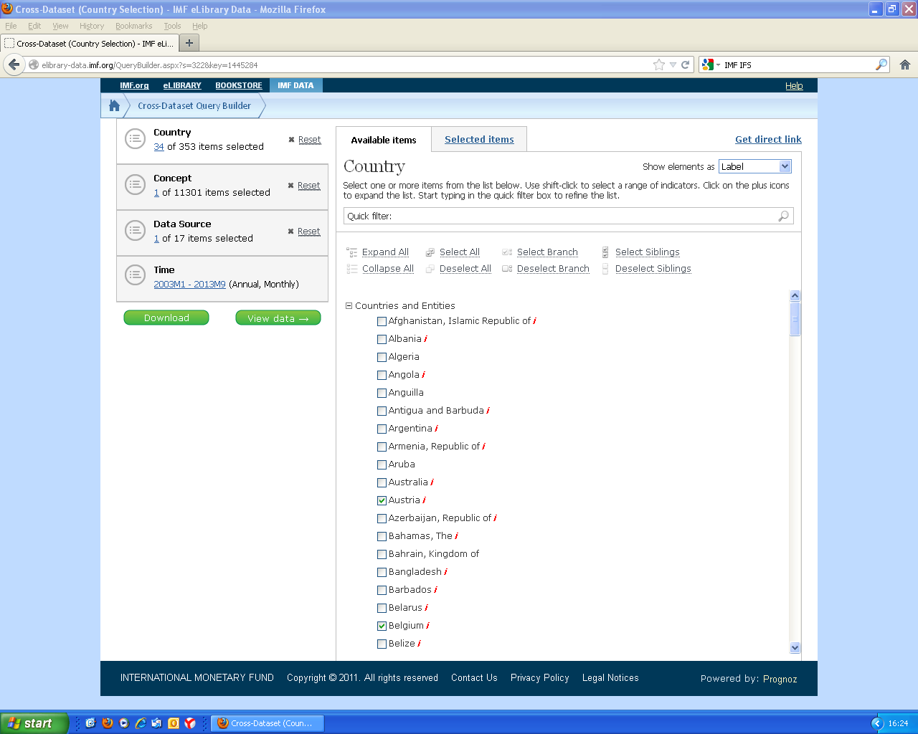
Data: Consumer and Producer Prices, IMF IFS

Slide 10
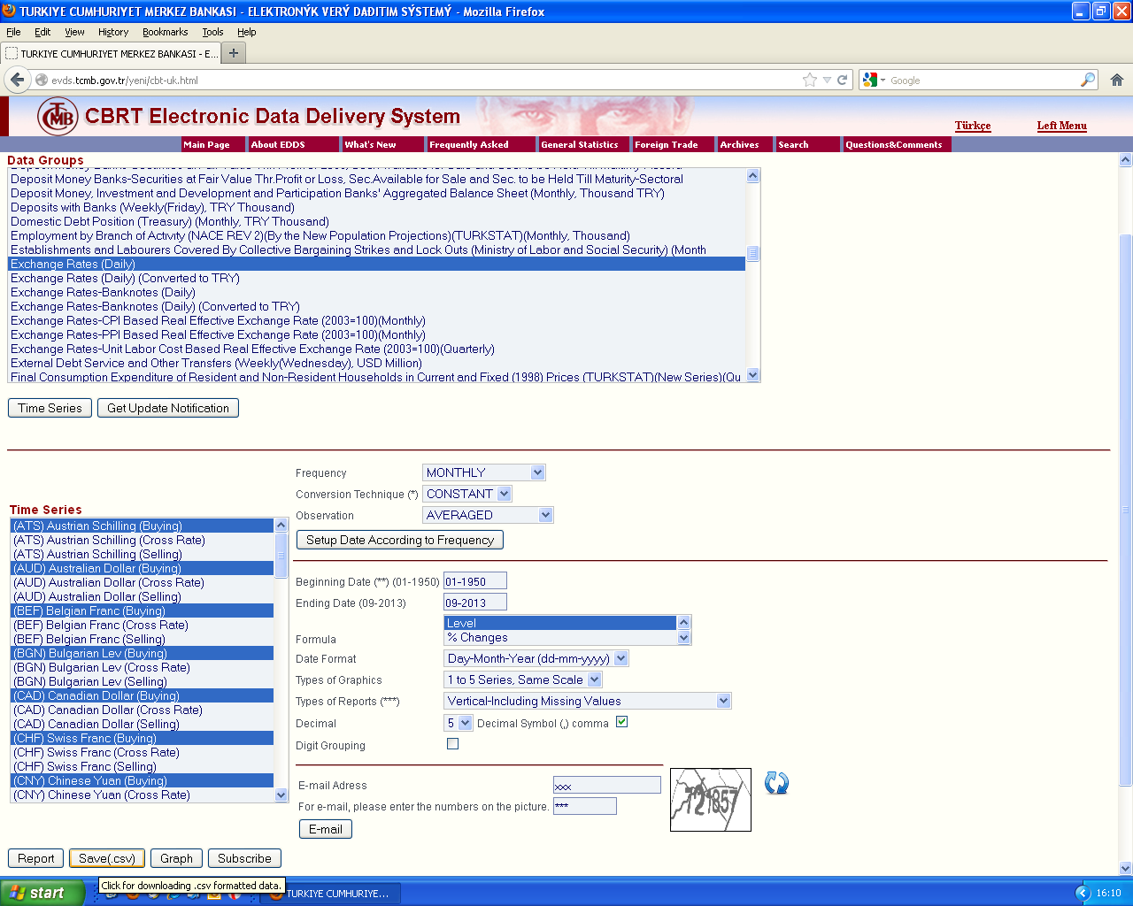
Data: Exchange Rates, CBRT EDDS

Slide 11
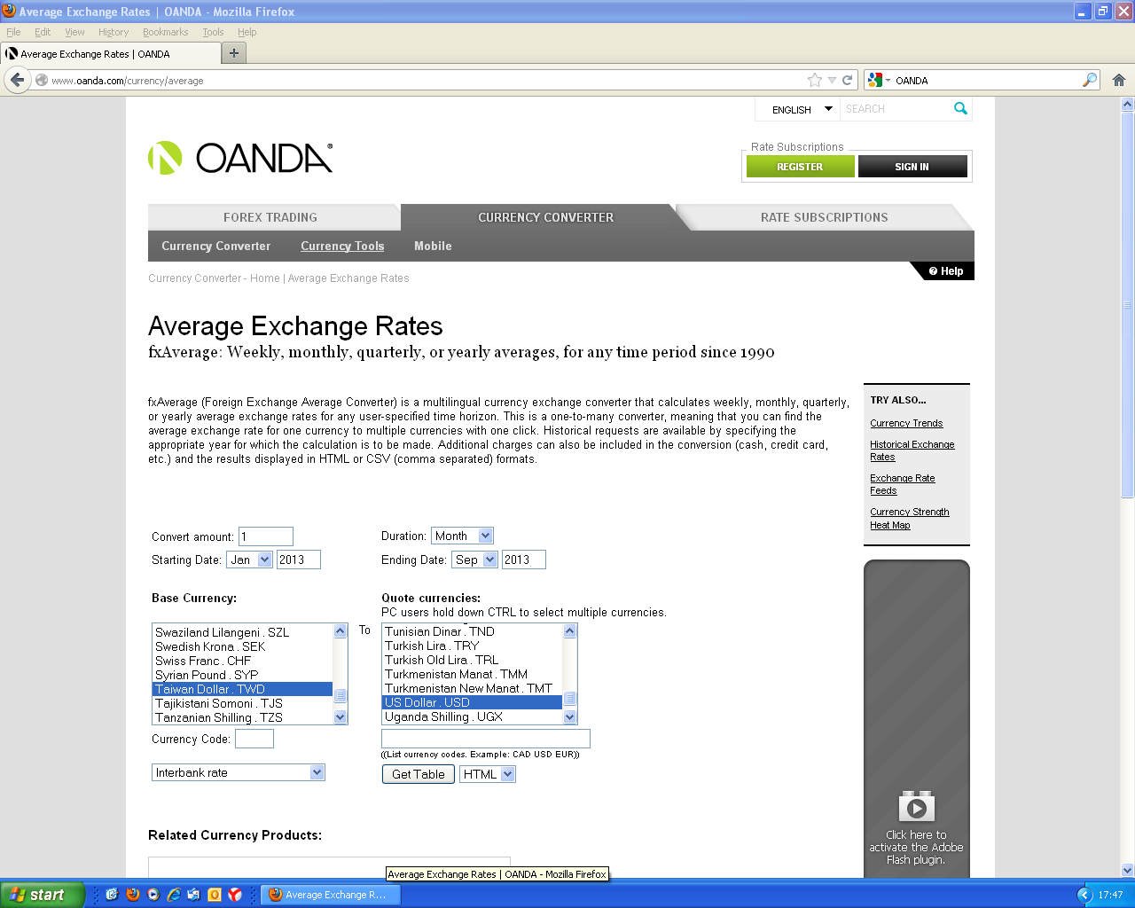
Data: Exchange Rates, OANDA

Slide 12
Consumer Price Index (CPI) Based REER (2003=100)

Slide 13
Producer Price Index (PPI) Based REER (2003=100)

Slide 14
Unit Labor Cost (ULC) Based REER* (2003=100)
(*) Due to the fact that Organisation for Economic Co-operation and Development (OECD) has terminated releasing unit labor cost data of countries, the data cannot be updated after 2012Q1.

Slide 15


the Central Bank of
the Republic of Turkey
http://www.tcmb.gov.tr/
Data/Periodic Data/
«Real Effective Exchange Rate»
Data/Statistical Data/
«Electronic Data Delivery System (EDDS)»
Turkish Lira Sign

