Slide 1
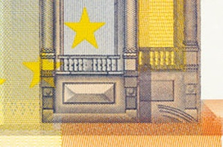
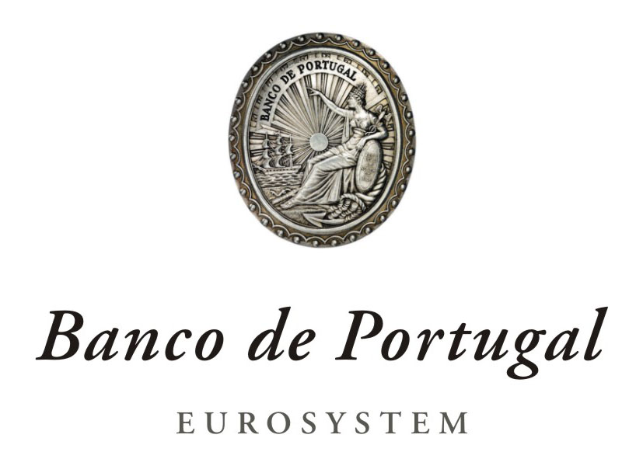
National Bank of the Republic of Macedonia
4th Conference on Payment and Securities Settlement Systems
PAYMENT HABITS IN PORTUGAL
Ohrid, 20 June 2011
Rui Pimentel
Payment Systems Department
Banco de Portugal

Slide 2

Payment Habits in Portugal
Agenda
  Retail Payment Systems in Portugal
  Role of Banco de Portugal
  SEPA Implementation & Impacts
  EU Trends vs Payment Habits in Portugal
  Conclusions

Slide 3
Payment Habits in Portugal
1. Retail Payment Systems in Portugal

Slide 4
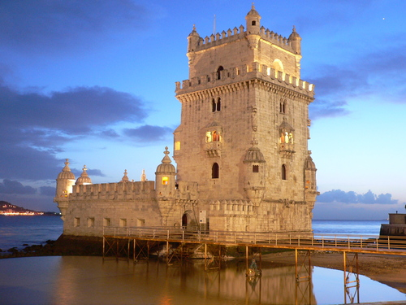
Payment Habits in Portugal
1. Retail Payment Systems in Portugal
Portugal – Country profile:
Area – 92 345 sq kilometres
Population – 10,6 million (2010)
GDP per inhabitant – 16 236 € (2010)

Slide 5

Payment Habits in Portugal
1. Retail Payment Systems in Portugal
The use of retail payment instruments in Portugal is very much based on transactions processed and cleared in SICOI, the national interbank clearing system, owned and regulated by Banco de Portugal, including several subsystems:
  Cheques
  Bills of exchange
  Credit Transfers
  Direct Debits
  Multibanco transactions
These include both legacy and SEPA solutions

Slide 6
Payment Habits in Portugal
2. Role of Banco de Portugal

Slide 7
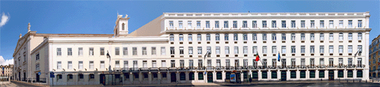
Payment Habits in Portugal
2. Role of Banco de Portugal
A member of the Eurosystem, Banco de Portugal acts as national central bank and performs the oversight and the catalyst functions in the Portuguese market regarding the smooth functioning of payment systems (as established in the Organic Law).
As a result, it shall be incumbent on Banco de Portugal to ensure the economic agents access to efficient, time-critical and secure payment systems.
http://www.bportugal.pt/en-US/SistemasdePagamento/Pages/default.aspx

Slide 8
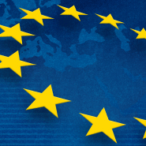
Payment Habits in Portugal
2. Role of Banco de Portugal
In the context of retail payments, currently the implementation of SEPA is a relevant project, not only for Banco de Portugal locally but for the Eurosystem as a whole.
Monitorisation and fostering of SEPA migration in the Portuguese market have been among the top tasks of Banco de Portugal in the field of retail payments in the last few years.

Slide 9

Payment Habits in Portugal
2. Role of Banco de Portugal
Governance structure – To foster dialogue with market participants, Banco de Portugal set up two consultative bodies:
Payment Systems Interbank Commission (CISP)
Payment Systems Forum – includes a dedicated SEPA Steering Committee

Slide 10
Payment Habits in Portugal
2. Role of Banco de Portugal
The Payment Systems Interbank Commission (CISP) is active since 1997, including a structure of working groups covering all payment instruments in use in the Portuguese market, both at steering committee and technical levels.
Chaired by Banco de Portugal, CISP includes representatives at board level from the State Treasury, the Portuguese Banking Association, SIBS (interbank services provider) and the major banks. Co-operative initiatives in this field are discussed at CISP level.

Slide 11

Payment Habits in Portugal
2. Role of Banco de Portugal
In order to achieve a necessary dialogue on the use and evolution of payment systems involving end-users, the Payment Systems Forum was created in 2009, including a dedicated SEPA Steering Committee.

Slide 12
Payment Habits in Portugal
2. Role of Banco de Portugal
A number of relevant stakeholders are represented in the Forum, again chaired by Banco de Portugal.
Apart from financial institutions and SIBS, it also includes representatives from the most active Public Administration entities as regards the use of retail payment instruments (treausry, social security, tax agency, municipalities), as well as Consumer Organisations and companies that are “Big Billers” (utilities, telcos, energy, water supply, insurance) and the most relevant Retailers.

Slide 13
Payment Habits in Portugal
3. SEPA Implementation & Impacts

Slide 14
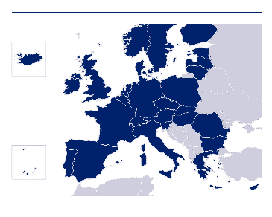
Payment Habits in Portugal
3. SEPA Implementation & Impacts
The implementation of SEPA poses new challenges as a result of its harmonisation goals and greater market integration.
Interbank payment operations are mostly national
Payment habits are heterogeneous across countries
SEPA also brings a new reality for a traditionally bank-dominated domain

Slide 15

Payment Habits in Portugal
3. SEPA Implementation & Impacts
In Portugal, SEPA migration levels are still at relatively low as a result of several factors:
Extensive range of services available at the Multibanco network (ATMs & POSs)
  Cash withdrawals Enquiries/Statements Bill payments (utilities, taxes, etc)
  Direct Debits Interbank Credit Transfers PIN change
  Cheque books request MB Phone (some operations are available on mobile phones)
  Motorway tolls Public transport Tickets
Portuguese community AOS – namely in direct debits

Slide 16


Payment Habits in Portugal
3. SEPA Implementation & Impacts
In Portugal, SEPA migration levels are still relatively low as a result of several factors (cont):
Migration of Social Security pensions and other payments (2011)
Challenges: establishment of end date(s) via EU Regulation; MIF in direct debits; enhance migration levels
SCT – 2,6%
SDD – residual
April 2011
In the field of SEPA communication, Banco de Portugal lauched an institutional video and in January 2011 started to publish a newsletter.

Slide 17
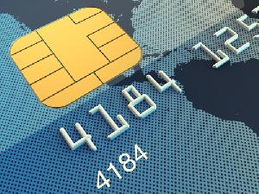
Payment Habits in Portugal
3. SEPA Implementation & Impacts
In the field of cards, a relevant issue for the completion of SEPA is the EMV migration process – an essential step to make card transactions SEPA-compliant
Available indicators show progress but there’s still room for improvement

Slide 18
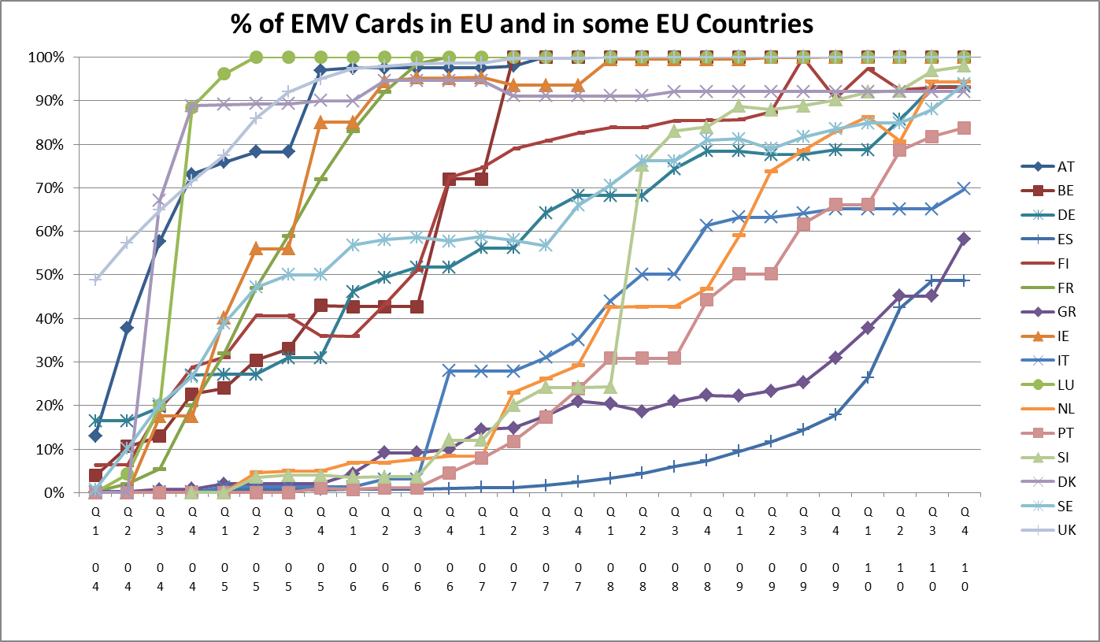
Payment Habits in Portugal
3. SEPA Implementation & Impacts
Source: ECB

Slide 19
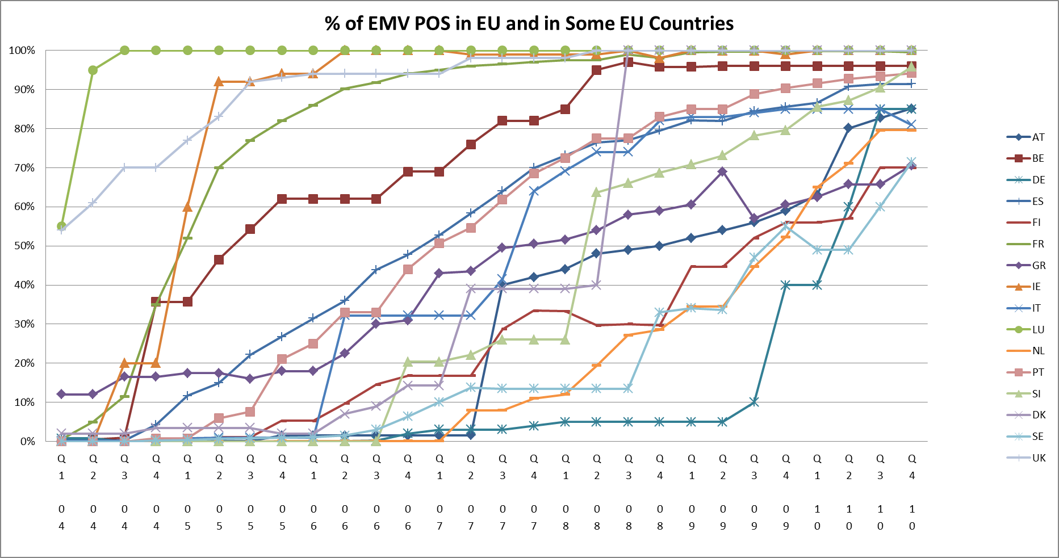
Payment Habits in Portugal
3. SEPA Implementation & Impacts
Source: ECB

Slide 20
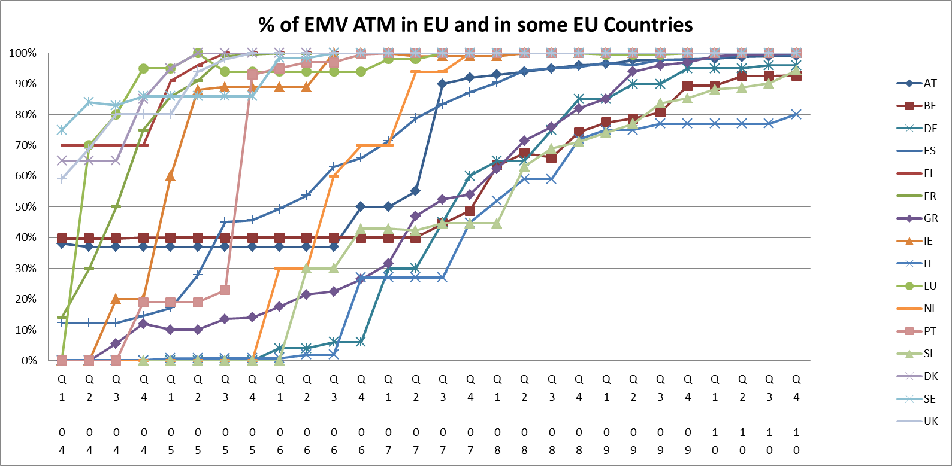
Payment Habits in Portugal
3. SEPA Implementation & Impacts
Source: ECB

Slide 21
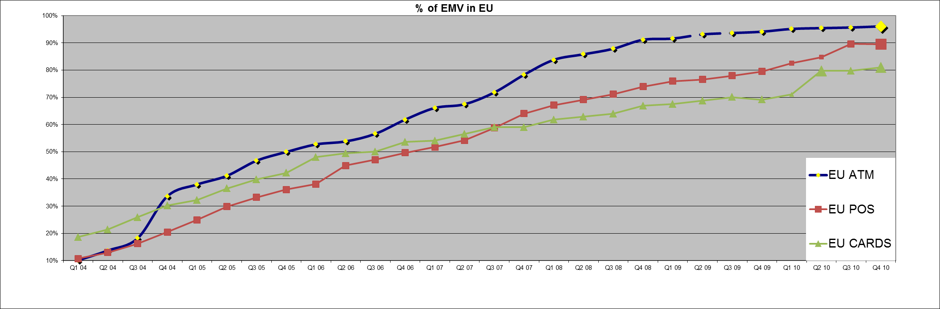
Payment Habits in Portugal
3. SEPA Implementation & Impacts
Source: ECB

Slide 22
Payment Habits in Portugal
3. SEPA Implementation & Impacts
In the case of Portugal, figures for April 2011 show the following migration indicators:
    ATM – 100%
    POS – 95%
    Cards – 84%
Towards the year-end, the expectation is to achieve a near-complete migration
However, as the cards market has global reach, EMV migration still has challenges to overcome

Slide 23
Payment Habits in Portugal
3. SEPA Implementation & Impacts
The migration process is most significant in Europe with several other countries already moving towards EMV
However, in spite of some initiatives, the USA are still lagging behind in this respect
(…) Chip and personal identification number (PIN) is old hat on the European side of the pond, but US banks – and consumers - are no closer to upgrading their card infrastructure than they were in 1999, when American Express first tried selling Americans 'Blue' smart cards. (…)
Bob Sullivan, EPC Newsletter 28.04.2011 – “The Magnetic Stripe: Why it is Hard for Americans to Say Good-Bye”

Slide 24
Payment Habits in Portugal
4. EU Trends vs Payment Habits in Portugal

Slide 25
Payment Habits in Portugal
4. EU Trends vs Payment Habits in Portugal
In several European countries – including Portugal – studies have been carried out since 2002 by National Central Banks on the costs of the use of payment instruments, namely comparing the cost of using cash, vis à vis the use of electronic instruments.
The ECB plans to carry out a similar study with European-wide reach, with a harmonised methodology among countries to allow comparability.
This initiative is to be completed on a voluntary basis – Several countries committed to participate.
http://www.bportugal.pt/en-US/SistemasdePagamento/Publicacoes1/Tumbnails%20List%20Template/Study%20-%20July%202007.pdf

Slide 26
Payment Habits in Portugal
4. EU Trends vs Payment Habits in Portugal
In the study carried out by Banco de Portugal (published in 2007 with 2005 data), conclusions show that the coverage rate of the total revenues generated by payment instruments is only of 63.4% of the total costs.
Coverage rate
Total revenues
722,0 M€
63,4%
Total costs
1.138,7 M€
This leads to the conclusion that there is cross-subsidisation of the use of payment instruments by other banking products.

Slide 27
Payment Habits in Portugal
4. EU Trends vs Payment Habits in Portugal
When comparing in more detail the unit costs and revenues for all payment instruments considered – from the banks’ perspective –, there are significant differences between them, where cash is clearly the one with a worse coverage rate (i.e. the least efficient in this respect), as opposed to credit cards and direct debits (the most efficient ones – higher revenues vs costs per transaction).
4.3%
39.4%
81.5%
92.7%
107.5%
159.5%
Cash
Cheques
DebitCards
Credit Transfers
Credit Cards
Direct Debits
Unit cost
1,85 €
1,45 €
0,23 €
0,28 €
2,44 €
0,09 €
Unit revenue
0,08 €
0,57 €
0,18 €
0,26 €
2,62 €
0,15 €

Slide 28
Payment Habits in Portugal
4. EU Trends vs Payment Habits in Portugal
The use of cashless payment instruments in Portugal has been steadily growing in the last few years, whereas the number of cheques issued has seen a sharp reduction.
In the context of the EU as a whole, country profiles vary considerably regarding the use of payment instruments, as shown from data published by the ECB (figures for 2010 not yet available).
Source: Blue Book (ECB, Statistical Data Warehouse)

Slide 29
Payment Habits in Portugal
4. EU Trends vs Payment Habits in Portugal
Regarding the use of cards in the context of the EU, recent data collected by the ECB shows that the number of cash withdrawals at ATMs has consistently been substituted by payment transactions at the point-of-sale through the last 10 years (figures for 2010 not yet available). This is particularly true in the nordic countries.
Source: Blue Book (ECB, Statistical Data Warehouse)

Slide 30
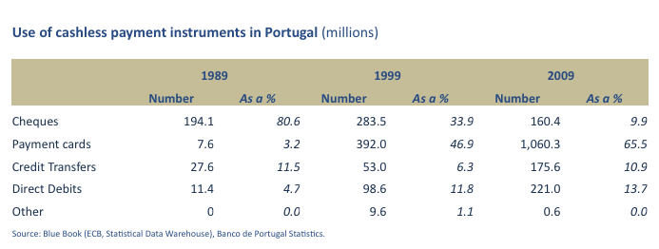
Payment Habits in Portugal
4. EU Trends vs Payment Habits in Portugal
Regarding the Portuguese case, the trend in the last 20 years has been of a significant growth in the use of electronic payments, in particular the use of cards, while credit transfers and direct debits also became more widely used during this period (figures for 2010 not yet available).
A 140-fold growth

Slide 31
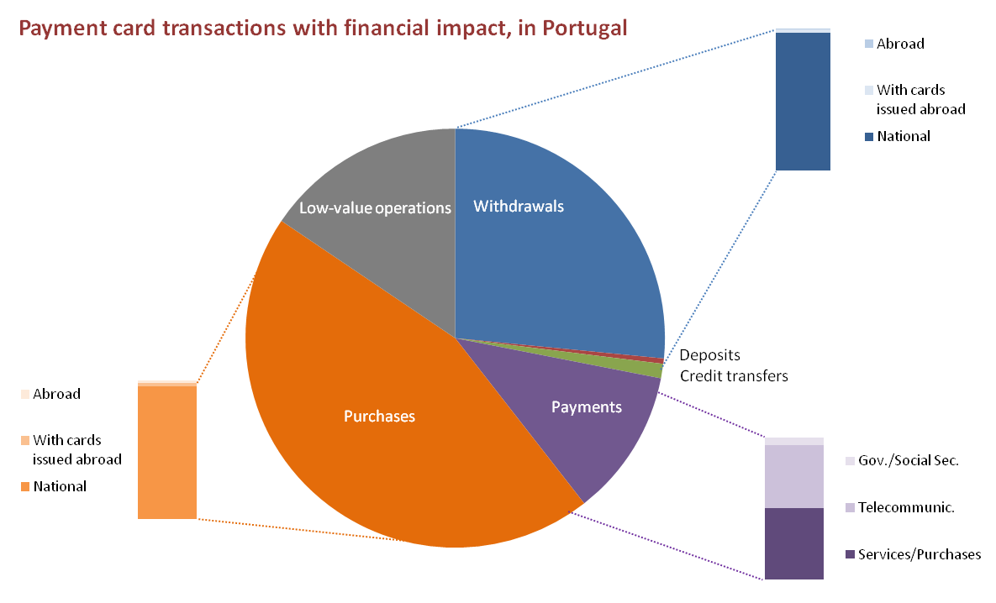
Payment Habits in Portugal
4. EU Trends vs Payment Habits in Portugal
Given the wide variety of available transactions in the Multibanco network, Portugal’s country profile concerning the usage of payment cards – for transactions with financial impact – is currently the following (2010 data):
Source: Banco de Portugal statistics

Slide 32
Payment Habits in Portugal
4. EU Trends vs Payment Habits in Portugal
In parallel with the growth in the use of cards, also credit transfers have gained relevance in the context of the use of cashless payment instruments in Portugal since 2000, with a noticeable and steady growth not only in total volumes but also with diversified types of transactions:
Source: Banco de Portugal statistics

Slide 33
Payment Habits in Portugal
5. Conclusions

Slide 34

Payment Habits in Portugal
5. Conclusions
In the changing landscape of retail payments in Europe, several challenges lie ahead and Portugal is no exception
Further market integration will be achieved in the medium term, with the full implementation of SEPA, eliminating fragmented, national-only, payment solutions & schemes
In this context, all transactions in euro will become “domestic”, after national solutions/schemes are phased out

Slide 35
Payment Habits in Portugal
5. Conclusions
Security issues – Fraud prevention on remote payments
Regulatory issues – New entrants can now have access to a traditional field of banking services: Payment Institutions
New channels & innovative products will emerge: mobile & contactless payment solutions, e-payments linked to e-invoicing
New payment habits for end users

Slide 36

Payment Habits in Portugal
Questions

Slide 37
Payment Habits in Portugal
THANK YOU
Rui Pimentel
Head of the Payment Systems Analysis and Development Unit
Payment Systems Department
Banco de Portugal
+351.21.3130944
rpimentel@bportugal.pt

