Slide 1

IV^{-th} Conference on Payments and Securities Settlement Systems
–NBRM–
Macedonian Project of the Direct Debit Scheme
Ohrid, 2011

Slide 2
Direct Debit Scheme
SEPA Framework
The Macedonian Project

Slide 3
Direct Debit Scheme
SEPA Framework
History
Vision and Objectives
The Four Corner Model
Business and Operational Rules
Logistical data
Physical data
E – framework
The Clearing Framework
The Legal Framework

Slide 4
HISTORY
About the EPC
The EPC is the decision – making and coordination body of the European banking industry in relation to payments whose declared purpose is to support and promote the creation of SEPA
The vision for SEPA was formulated in 2002 at the time of the launch of EPC, when some 42 banks, the three European Credit Sector Associations (ECSAs’) and the Euro Banking Assosiation (EBA) came together and, after an intensive workshop, release the White Paper (reference [8]) of the Euroland: Our Single European Payments Area
We share the common vision that Euroland payments are domestic payments
We join forces to implement this vision for the benefit of European customers, industry and banks accordingly,
We launch our Single Payments Area
Any extension of the geographical scope of SEPA is subject to detailed evaluation by the EPC against criteria for candidate SEPA countries as approved from time to time by the EPC Plenary.

Slide 5
Vision and Objectives
The Scheme provides a set of inter-bank rules, practices and standards which will allow the banking industry in SEPA to offer a direct debit product to Customers. As a result, all core direct debits, whether ‘domestic’ or ‘cross-border’, will be provided on the same essential conditions and modalities throughout SEPA.

Slide 6
The Four Corner Model

Slide 7
Actors and the connections between them

Slide 8
Business and Operational Rules
ADVANTAGES
Creditor
A simple and cost – efficient way of paying the bills, without any risk of latent payments and consequences of that follow from latent or no payments
The possibility to determine the exact date of Collection
The security that the payment will be made in the anticipated Flow Time Cycle
The possibility to optimize the cash flows and the cash management
Direct settlement of the received payments
The possibility to automatize the irregular situations such as: Return, Reject, Refund, and Reversal
One payment instrument everywhere in SEPA for the Creditors that have a bank account in SEPA
The possibility to collect funds for the Debtors through the usage of a single payment instrument
The reduction of the administrative costs and the increase of the security as a result of the possibility to use electronic signatures for signing the Mandates, after the electronic signatures become available.

Slide 9
Business and Operational Rules
ADVANTAGES
Debtor
A simple way of paying the bills, without the risk of a latent payment, and the consequences that follow from latent payments
The Debtor is easily accessible for the SEPA – business offers, because the Scheme is unique, trustworthy, payment service for all Creditors in SEPA.
Direct settlement of the dues on the accounts.
The possibility to sign a paper Mandate, or to use the entirely electronic Direct Debit, when the electronic signatures become available.
Fast and simple procedures for Refunds, which are available in the period of 8 weeks from the date of collection.

Slide 10
Business and Operational Rules
ADVANTAGES
Banks
The processes are automated and cost – efficient, and are entirely dematerialized
The cycle of processing is clear, transparent, and secure
It provides an appropriate management of the obligations and the risks
Risk mitigation in the interbank settlement, and in general on the interbank level
The Creditors must show proof of having appropriately filled and signed Mandates at any time
The Scheme provides STP (Straight – Through – Processing) of all transactions, including (with a clear reference to the original transaction) Rejects, Returns, Refunds, and Reversals
The Scheme creates conditions that will allow each Participant to create products which will generate reasonable financial returns, enough to ensure safety, security, and integrity of the Scheme
Easy to implement
Using standards such as ISO BIC and the European IBAN as bank and account identifiers
Clear identification of all SEPA Creditors of Direct Debit
Renaming of a set of compliant rules and standards.

Slide 11
Business and Operational Rules
ADVANTAGES - KIBS
The Direct Debit Scheme
is available to the Creditors and the Debtors as long as they have an account at any bank which has adhered to the Scheme

Slide 12
Business Rules
Processes
PR – 01 Issuing the Mandate
PR – 02 Amendment of the Mandate
PR – 03 Cancellation of the Mandate
PR – 04 Collection of the Direct Debit
PR – 05 Reversal of a Collection
PR – 06 Obtain a copy of a Mandate

Slide 13
Logistical data – Data Sets
DS-01 Mandate
DS-02 The Dematerialized Mandate
DS-03 Customer to Bank Collection
DS-04 The inter – bank Collection
DS-05 Direct debit Rejection, Return or Refund of a Collection or a Reversal
DS-06 Bank to Customer Direct Debit Information
DS-07 The inter – bank Reversal for a Collection by the Creditor
DS-08 The request and response message for a claim for the Refund of an Unauthorized transaction
DS-09 The request and response template for a claim for the Refund of an unauthorized transaction
DS-10 The request message for obtaining a copy of a Mandate
DS-11 The template for the request and the response for obtaining a copy of a Mandate

Slide 14
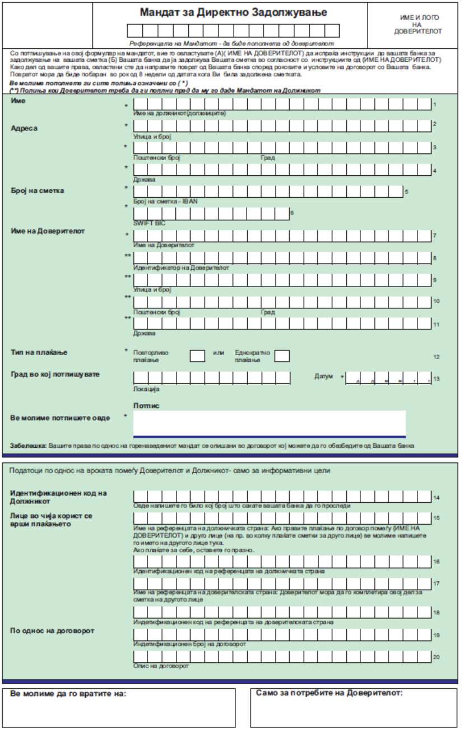

Slide 15
Physical Data
AT-01- The unique Mandate Reference
AT-02- Identifier of the Creditor
AT-03- the name of the Creditor
AT-04- The account number (IBAN) of the Creditor
AT-05- The address of the Creditor
AT-06- The amount of the Collection in euro
AT-07- The account number (IBAN) of the Debtor
AT-08- The identifier of the underlying contract
AT-09- The address of the Debtor
AT-10- The Creditor’s reference of the Direct Debit Transaction
AT-11- The Due Date of the Collection
AT-12- BIC code of the Creditor Bank
AT-13- BIC code of the Debtor Bank
AT-14- The name of the Debtor
AT-15 – The name of the Debtor reference Party
AT-16 – The placeholder for the electronic signature data
AT-17- The type of Mandate (paper, e-mandate)
AT-18 – The identifier of the original Creditor who issued the Mandate
AT-19 – The unique reference as given by the original Creditor who issued the Mandate
AT-20 – The identification code of the Scheme
AT-21 – The transaction type
AT-22 – The Remittance information sent by the Creditor to the Debtor in the Collection
AT-24 – The reason for amendment of the Mandate
AT-25 – The date of signing of the Mandate
AT-26 – The Settlement date of the Mandate
AT-27 – Debtor identification code
AT-31 – The Reversal reason code
AT- 33 – The signature(s) of the Debtor(s)
AT- 36 – The signing date of the cancellation of the Mandate
AT- 37 – The identification code of the Debtor reference party
AT-38 – The name of the Creditor reference party
AT-39 – The identification code of the Creditor reference party
AT-43 – The Creditor’s bank reference of the Collection
AT-44 – The amount of the Reversal in euro
AT-45 –The debtor’s Bank reference of the request
AT-46 – The Refund request type code
AT-47 – The date of receipt of the request by the Debtor Bank
AT-48 – The Date of sending the request by the Debtor Bank
AT-49 – The Name of the Debtor Bank
AT-50 – The Debtor bank contact details
AT-51 – E-mail address or fax number of the Debtor Bank where the copy of the Mandate should be sent
AT-52 – The indication that a confirmation of the receipt of the request by the Creditor Bank is requested (yes/no)
AT-53 – The Debit date of the Collection
AT-54 – The last Collection date
AT- 55- The Cancellation date
AT-56 – The Reference of the response of the Creditor
AT-57 – The Response type codes
AT-58 – The purpose of the Collection
AT-59 – The category purpose of the Collection
AT-R1- Type of “R” message
AT-R2- Identification of the type of party initiating the “R” message
AT-R3- The reason code for non-acceptance
AT-R4- The settlement date for the Return or Refund instruction (DS-05) or the Reversal (DS-07)
AT-R5- Specific reference of the bank initiating the Reject/Return/Refund for Reject/Return/Refund
AT-R6- The Refund compensation recovered by the Debtor Bank from the Creditor bank
AT-R7-The specific reference of the Creditor Bank for the Reversal
AT-R8 – The amount of the Balancing Payment agreed between the Debtor Bank and Creditor Bank

Slide 16
E – Framework
The E – operational model covers the aspects such as:
Guaranteed delivery,
The irrevocability of the sending/receiving
Authentication of the sender,
Integrity of data,
encryption, compression,
In accordance with the defined working conditions, rules, and practices.

Slide 17
The Clearing Framework
PE–ACH/CSM Framework sets the principles with which the Clearing House supports the Scheme
The Scheme and the infrastructure are defined in special documents, and because of this the PE – ACH/CSM Framework is an important complementary document.

Slide 18
Macedonian Project of the Direct Debit Scheme
The National Payments System Council
  NBRM
  The Ministry of Finance
  The Banking Association
The Work Group
  Electronic Direct Debit
  Legal Issues
Chambers of Commerce – creditors
Consumer Associations – debtors

Slide 19
Macedonian Project of the Direct Debit Scheme
Preparation of the Regulation – the Rulebook
  Draft Version 01.04.2011
  Final Version 30.06.2011
Pilot testing – 01.05.2011
  Paper mandate version
  Е -mail
Simulator – 01.10.2011
  Banks
  Creditors
  Debtors

Slide 20
Objectives of the Rulebook
To be the primary source for the rules, regulations, and obligations within the Scheme
To offer the official information to the Participants and the other concerned parties, about how the Scheme functions
To provide the Participants, the Clearing House, and the suppliers of the software solutions with important information concerning the development and the working of this payment instrument.

Slide 21
Pilot Testing
To test the processes, the logistical and physical data.
To acquire materials for the functioning of the Scheme
To create a basis for the designing of the software solution.

Slide 22
Simulator
To test the processes, the logistical and physical data, in each role of the Actors included.
Learning about the functioning of the Scheme
Basis for designing the software solution
A helping tool in the preparation of the application solutions.
Training of future users
Promoting and providing information about the product

Slide 23
Macedonian Project of the Direct Debit Scheme
Implementation – Measures
2011
Education about the product
Simulations
Seminars
2012
Promotion
Campaign
2011
Assigning people
Participation in the Simulator
Determining a budget
2012
Marketing
Sale

Slide 24

Thank you for your attention
m–r Nikola Paunkoski
Ph. num. 02 3297451
nikolap@kibs.com.mk

Slide 25
QUESTIONS

