Slide 1


National Bank of the Republic of Macedonia
6th Conference on Payment and Securities Settlement Systems
How to get more secure and convenient payments in Europe?
Ohrid, 1 July 2013
Rui Pimentel
Payment Systems Department
Banco de Portugal

Slide 2
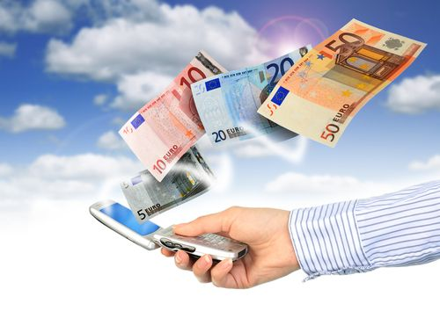
How to get more secure and convenient payments in Europe?
Agenda
  Technological developments – Influence in retail payments
  Security versus Convenience
  Co-operative approach taken by European authorities
  Outlook

Slide 3
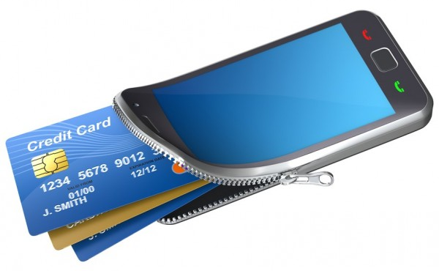
How to get more secure and convenient payments in Europe?
1. Technological developments – Influence in retail payments

Slide 4
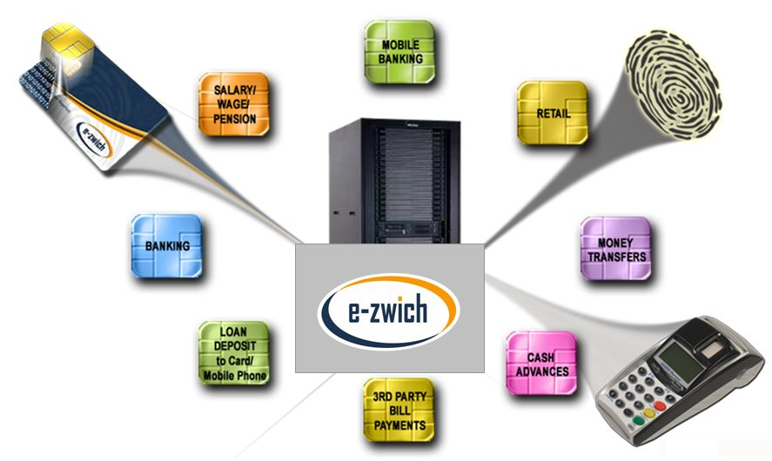

How to get more secure and convenient payments in Europe?
1. Technological developments – Influence in retail payments
The new trends in payments are significantly affected by technological advances:
  Internet-based payment solutions have today a widespread offer
  Payment Service Providers have been developing a multi-channel approach

Slide 5

How to get more secure and convenient payments in Europe?
1. Technological developments – Influence in retail payments
The new trends in payments are significantly affected by technological advances:
  At the same time
  The World is growingly mobile…
  …and so are payments…

Slide 6
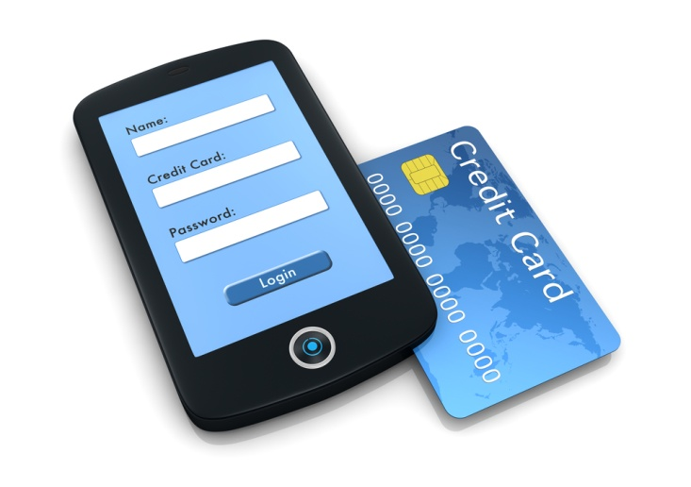
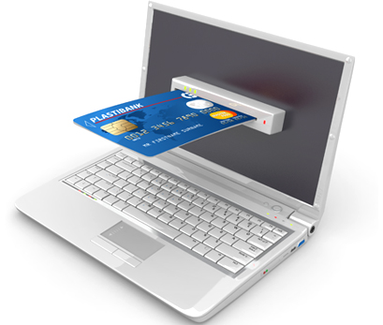
How to get more secure and convenient payments in Europe?
1. Technological developments – Influence in retail payments
The new trends in payments are significantly affected by technological advances:
  …giving way to mobile payment solutions and a blurred border between e- & m-payments
As a consequence, raising security issues that need to be tackled to foster confidence of end-users!

Slide 7

How to get more secure and convenient payments in Europe?
2. Security versus Convenience

Slide 8
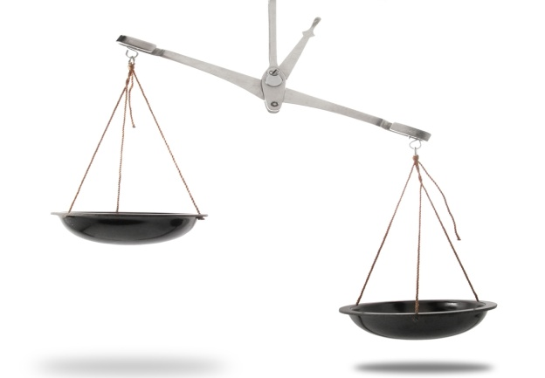
How to get more secure and convenient payments in Europe?
2. Security versus Convenience
The correct balance between a simple, appealing offering and a secure payment product remains a challenge for banks and other providers
  On the one hand, innovative payment services proliferate from multiple market players...
  ...Whereas, one the other hand new fraud types are also developed

Slide 9
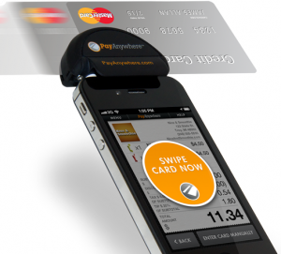

How to get more secure and convenient payments in Europe?
2. Security versus Convenience
Also for regulators, this shall be a relevant issue to be tackled
  Competition among service providers creates a dynamic market with a wide choice of (payment) products
  But vulnerabilities need to be addressed to ensure the soundness of solutions offered

Slide 10
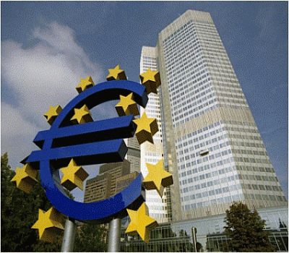
How to get more secure and convenient payments in Europe?
3. Co-operative approach taken by European authorities

Slide 11
How to get more secure and convenient payments in Europe?
3. Co-operative approach taken by European authorities
A year ago, we discussed the creation of the European Forum on the Security of Retail Payments (SecuRe Pay Forum)
Voluntary cooperation between entities in charge of oversight & prudential
supervisors in the EU / EEA; European Commission and Europol participate as
observers
  Establishment of common knowledge and understanding with regard to electronic retail payment services, instruments & PSPs
  Address major security weaknesses and vulnerabilities
  Harmonized recommendations

Slide 12
How to get more secure and convenient payments in Europe?
3. Co-operative approach taken by European authorities
This year, we can discuss the deliverables that resulted from activities carried out by the SecuRe Pay Forum in 2012 and 2013
  In 2012, the public consultation of the draft Recommendations on the Security of Internet Payments gave way to the analysis of responses from the market and work on a revised document
  The structure includes 14 Recommendations with a substantial focus on Strong Customer Authentication (SCA)
On 31 January 2013, the final Recommendations were published for adoption no later than 1 February 2015

Slide 13
How to get more secure and convenient payments in Europe?
3. Co-operative approach taken by European authorities
This year, we can discuss the deliverables that resulted from activities carried out by the SecuRe Pay Forum in 2012 and 2013
  In terms of addressees, the recommendations, key considerations and best practices specified in this report are applicable to all PSPs, as defined in the Payment Services Directive, providing internet payment services, as well as to governance authorities (GAs) of payment schemes (e.g. card payment schemes)
  The purpose of this report is to define common minimum requirements for the internet payment services as identified, regardless of the access device used

Slide 14
How to get more secure and convenient payments in Europe?
3. Co-operative approach taken by European authorities
This year, we can discuss the deliverables that resulted from activities carried out by the SecuRe Pay Forum in 2012 and 2013
  Regarding the structure and content, the recommendations are organised according to the following model:
Categories | RECs
General control and security environment | 1 – 5
Specific control and security measures for internet payments | 6 – 11
Customer awareness, education and communication | 12 – 14

Slide 15
How to get more secure and convenient payments in Europe?
3. Co-operative approach taken by European authorities
This year, we can discuss the deliverables that resulted from activities carried out by the SecuRe Pay Forum in 2012 and 2013
  General control and security environment
    REC 1 Governance
    REC 2 Risk assessment
    REC 3 Incident monitoring and reporting
    REC 4 Risk control and mitigation
    REC 5 Traceability

Slide 16
How to get more secure and convenient payments in Europe?
3. Co-operative approach taken by European authorities
This year, we can discuss the deliverables that resulted from activities carried out by the SecuRe Pay Forum in 2012 and 2013
  Specific control and security measures for internet payments
    REC 6 Initial customer identification, information
    REC 7 Strong customer authentication
    REC 8 Enrolment for and provision of authentication tools and/or software delivered to the customer
    REC 9 Log-in attempts, session time out, validity of authentication
    REC 10 Transaction monitoring
    REC 11 Protection of sensitive payment data

Slide 17
How to get more secure and convenient payments in Europe?
3. Co-operative approach taken by European authorities
This year, we can discuss the deliverables that resulted from activities carried out by the SecuRe Pay Forum in 2012 and 2013
  Customer awareness, education and communication
    REC 12 Customer education and communication
    REC 13 Notifications, setting of limits
    REC 14 Customer access to information on the status of payment initiation and execution

Slide 18
How to get more secure and convenient payments in Europe?
3. Co-operative approach taken by European authorities
This year, we can discuss the deliverables that resulted from activities carried out by the SecuRe Pay Forum in 2012 and 2013
  Following publication on 31 January 2013 there’s a 2-year period for adoption by the market
  Dialogue with parties involved to gain traction in 2014, fostering active implementation
  An assessment guide covering all Recommendations is to be prepared

Slide 19
How to get more secure and convenient payments in Europe?
3. Co-operative approach taken by European authorities
This year, we can discuss the deliverables that resulted from activities carried out by the SecuRe Pay Forum in 2012 and 2013
  In addition, also on 31 January 2013, a public consultation on the draft stance on Access to Payment Accounts was launched
  This document follows a similar structure but is focused on the activities of Third Party Providers (TPP)
  From this consultation resulted several responses from the market and the next steps are also influenced by the revision of the Payment Services Directive regarding the activities of TPP
  http://www.ecb.int/press/pr/date/2013/html/pr130131_1.en.html

Slide 20
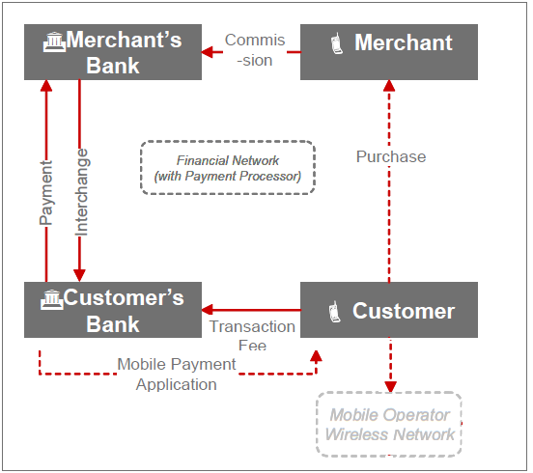
How to get more secure and convenient payments in Europe?
3. Co-operative approach taken by European authorities
Other areas that have been discussed
  Risk analysis in mobile payments – Envisaged for future Recommendations aimed at the stakeholders of this ecosystem
  3 possible functional/business models are considered in this regard
1) PSP-centric

Slide 21
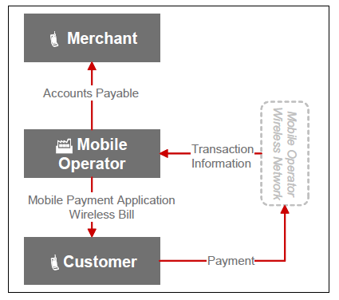
How to get more secure and convenient payments in Europe?
3. Co-operative approach taken by European authorities
  3 possible functional/business models are considered in this regard
2) MNO-centric

Slide 22
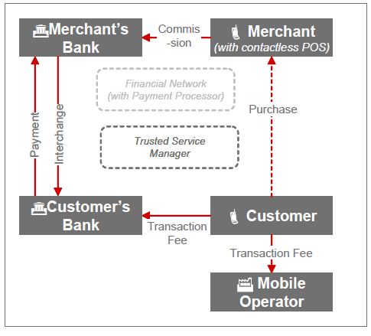
How to get more secure and convenient payments in Europe?
3. Co-operative approach taken by European authorities
  3 possible functional/business models are considered in this regard
3) Collaborative approach

Slide 23
How to get more secure and convenient payments in Europe?
3. Co-operative approach taken by European authorities
Other areas that have been discussed
  Information sharing on security incidents involving sensitive payments data
  A deeper co-operation framework involving authorities of different countries could be helpful, enhancing the efforts carried out at national level
  Knowledge about new types of attacks
  Enhancement of fraud prevention tools for future usage

Slide 24
How to get more secure and convenient payments in Europe?
3. Co-operative approach taken by European authorities
Other areas that have been discussed
  Some recent news have also highlighted this area
  Co-ordinated attack in several geographic areas of the world
  Focus on New York (reportedly, withdrawals in over 2900 ATMs in around 10 hours)
  Sophisticated approach – using prepaid card inormation
  http://www.nytimes.com/2013/05/10/nyregion/eight-charged-in-45-million-global-cyber-bank-thefts.html?pagewanted=all&_r=1&
  Total theft:
  45 million USD

Slide 25
How to get more secure and convenient payments in Europe?
3. Co-operative approach taken by European authorities
In addition to the deliverables produced by the SecuRe Pay Forum (in the context of the European System of Central Banks), other developments need to be pointed out
  The European Commission had already mentioned some topics on the relevance of security aspects of retail payments in the Green Paper “Towards an integrated European market for card, internet and mobile payments” launched in early 2012
  A public consultation took place in the months that followed the publication, resulting in over 300 replies
  Develpments in this stance by the EU Commission are expected soon

Slide 26
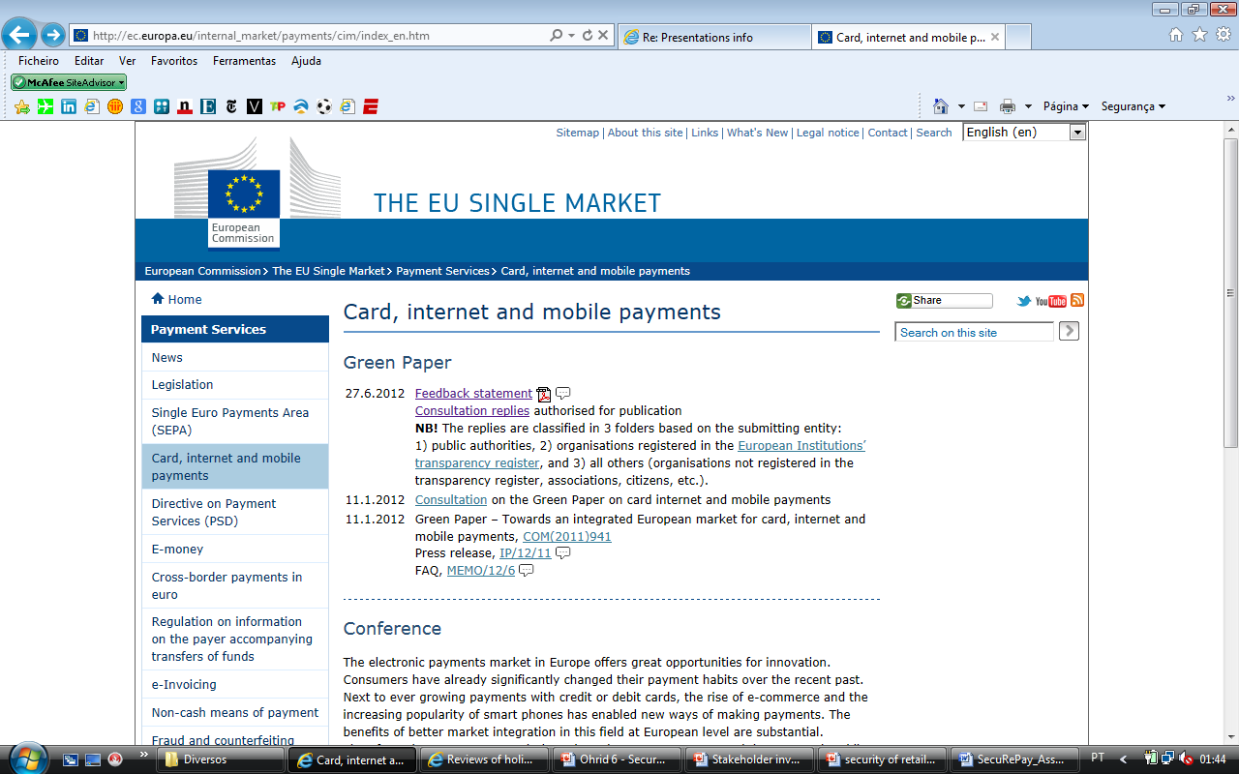
How to get more secure and convenient payments in Europe?
3. Co-operative approach taken by European authorities
  http://ec.europa.eu/internal_market/payments/cim/index_en.htm

Slide 27
How to get more secure and convenient payments in Europe?
3. Co-operative approach taken by European authorities
In addition to the deliverables produced by the SecuRe Pay Forum (in the context of the European System of Central Banks), other developments need to be pointed out
  Also Europol established Cyber Crime Center (EC3) as of the beginning of 2013
  Its mandate explicitly mentions that EC3 shall tackle threats to security such as cybercrimes that are
which affects critical infrastructure and information systems in the European Union
committed by organised groups to generate large criminal profits such as online fraud

Slide 28
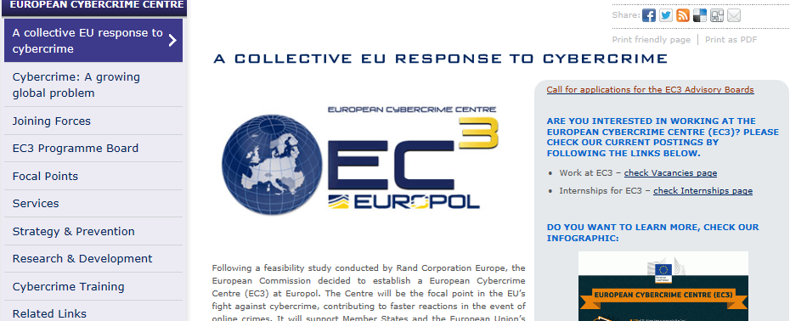
How to get more secure and convenient payments in Europe?
3. Co-operative approach taken by European authorities
  https://www.europol.europa.eu/ec3

Slide 29

How to get more secure and convenient payments in Europe?
4. Outlook

Slide 30
How to get more secure and convenient payments in Europe?
4. Outlook
In a context of growing innovation, consumer protection also takes a prominent role underpinning confidence in the solutions provided
Dialogue and co-operation between authorities plays a central role, as these issues gain added complexity
Security of solutions provided is of paramount importance
Compliance with Recommendations
However, competition in the market cannot be compromised

Slide 31

How to get more secure and convenient payments in Europe?

Slide 32
How to get more secure and convenient payments in Europe?
THANK YOU!
Rui Pimentel
Head of the Payment Systems Analysis and Development Unit
Payment Systems Department
Banco de Portugal
+351.21.3130944
rpimentel@bportugal.pt

