Slide 1
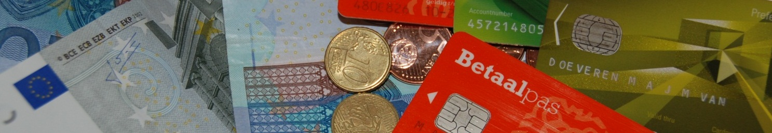


Future trends in Retail Payments
Ayse Zoodsma-Sungur and Rui Pimentel
Sixth Macedonian Financial Sector Conference on Payments and Securities Settlement Systems
Ohrid, 1-3 July 2013

Slide 2
Agenda
Foreword
Why do retail payments matter ?
Innovations and trends in the field of retail payments
Factors of success
Conclusion

Slide 3
FOREWORD
Over the past decade, a number of innovative developments in retail payments have emerged.
Many central banks take an interest in retail payments as part of their role in maintaining the stability and efficiency of the financial system and preserving confidence in their currencies.
Crucial to this objective is the role of ensuring the smooth functioning of payment systems, in the context of the ESCB

Slide 4
FOREWORD
Although most retail payment systems are not considered systemically important, their potential weaknesses with regard to security and reliability could nonetheless affect the financial system and the economy.
Innovations and trends in retail payments can therefore raise policy issues for Central Banks, and this is why the analysis of potential vulnerabilities is of paramount importance

Slide 5
Why do retail payments matter 1
Social costs of retail payment instruments
Study carried out in 13 countries
(published in September 2012 – ECB Occasional Paper no 137)
0.96 % GDP or 45 billion euro for participating countries
1 % GDP or 130 billion euro for all EU27
http://www.ecb.int/pub/pdf/scpops/ecbocp137.pdf
Notes:
Social relevance of retail banking
Taking deposits, providing credit to real economy, and provision of payment services to firms and households are key public services
Evidence positive impact of retail payments on economic growth
Advisory Committee on the Future of Banks in the Netherlands (“Restoring Trust”, Apr 2009)
UK HM Treasury (“Banking reform: delivering stability and supporting a sustainable economy”, Jun 2012)
ECB (“Retail payments and economic growth”, work in progress 2013)

Slide 6
Why do retail payments matter 2
Bank stability and performance
Efficient retail payment services associated with higher bank stability
Better bank performance (cost/benefits) in countries with more developed retail payment services
Retail payments integration is important tool for strengthening Europe’s competitiveness and growth

Slide 7
Why do retail payments matter 3
Social relevance of retail banking
Taking deposits, providing credit to the real economy, and provision of payment services to firms and households are key basic services
Evidence positive impact of retail payments on economic growth
Authorities set the direction by creating basic conditions, organizing social dialogue, imposing security requirements, updating legal framework
UK HM Treasury (“Banking reform: delivering stability and supporting a sustainable economy”, Jun 2012)
ECB (“Retail payments and economic growth”, work in progress 2013)

Slide 8
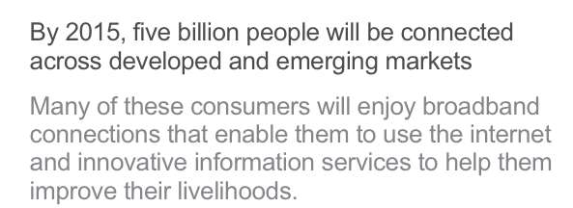
Retail payments innovations and trends
Reported from Nokia Siemens Networks

Slide 9







Retail payments innovations and trends 1
The world is increasingly becoming virtual
Internet has radically changed many types of industries
Music
Notes:
Napster was een online muziekdienst die oorspronkelijk als bestandsdeelservice was gemaakt door Shawn Fanning, John Fanning en Sean Parker. Napster was de eerste wereldwijd gebruikte peer-to-peer-muziekdeelservice, en heeft een grote invloed gehad op hoe mensen, vooral studenten, het internet gebruiken.
Itunes and Spotify Spotify is een Zweeds bedrijf dat in 2006 is opgericht en dat muziek als stream aanbiedt.^{[1]} Gebruikers kunnen uit een database van miljoenen nummers bepalen welke muziek ze willen beluisteren. Om opbrengsten te genereren wordt de uitzending door reclame onderbroken, maar tegen betaling is dit afkoopbaar. De dienst wordt gezien als alternatief voor iTunes.^{[2]}
The world is increasingly connected and always on

Slide 10

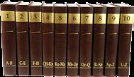
Retail payments innovations and trends 2
Publishing
Encyclopedia Wikipedia
Of course everything virtual affects banks as well as payments

Slide 11
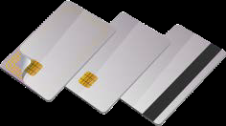
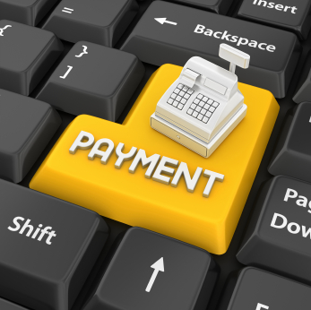
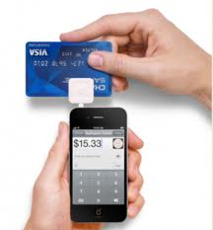
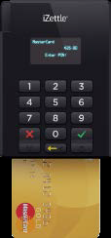
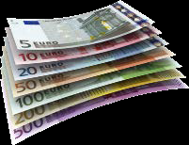
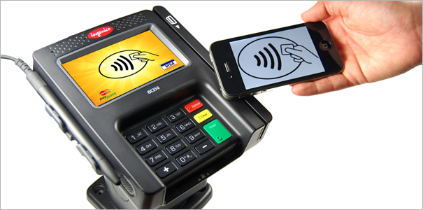
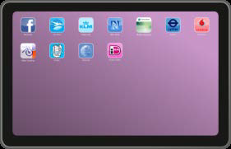
Retail payments innovations and trends 3
                Also payments change
Notes:
Cash, Cards , POS terminal, Mobile Swipe Cardreaders, EMV Card readers, mobile payments

Slide 12
Retail payments innovations and trends 4
Technology,consumer demands and new entrants are driving forces of innovations.
Internet & e-commerce
Smartphones & “apps”
Near Field Communication (NFC)
Social networks & virtual worlds
Mobile POS terminals
Blurred border e- versus m-...

Slide 13
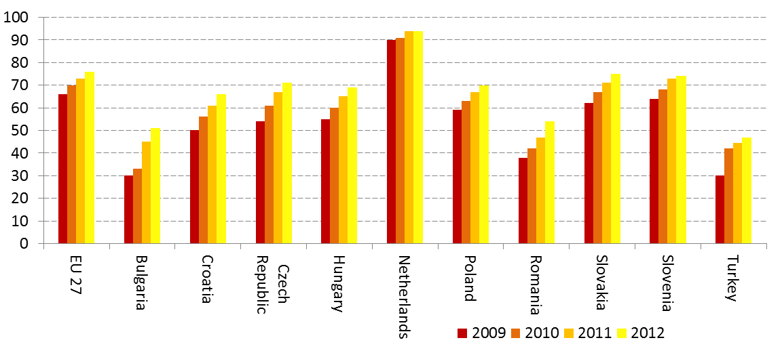
Retail payments innovations and trends 5
Percentage of households having internet access
(Eurostat, Feb. 2013)

Slide 14
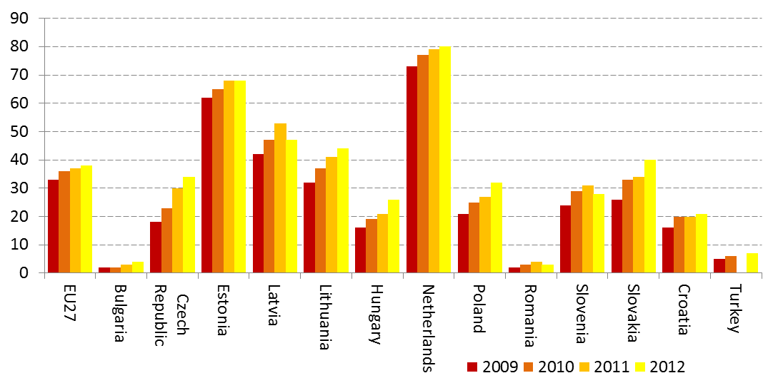
Retail payments innovations and trends 6 e-commerce
Individuals having bought goods online in the last three months
(Eurostat, Feb. 2013)

Slide 15
Retail payments innovations and trends 7
What is in it for consumers
Convenience
Speed
“Real time economy”
Safety & security
Anonymity
Financial inclusion

Slide 16
Retail payments innovations and trends 8
Who are the stakeholders
Banks & other Payment Service Providers
Card companies/schemes
Mobile Network Operators (MNOs)
Technology companies
Handset & terminal manufacturers
Regulators

Slide 17
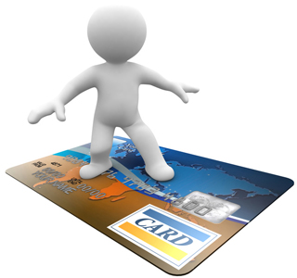

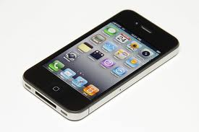

Retail Payment Innovations and trends 8
Card
Internet
Mobile

Slide 18
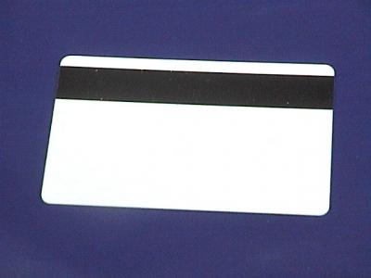
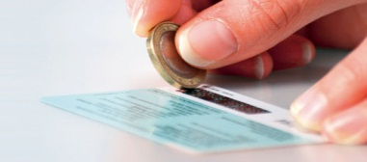


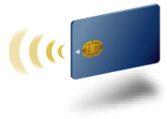
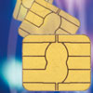
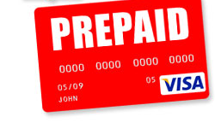
Retail Payment Innovations and trends 9 card
Notes:
Scratch, Gift, pre/paid, magnet/stripe, contact and contactless,EMV,

Slide 19

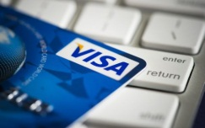


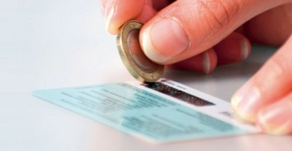
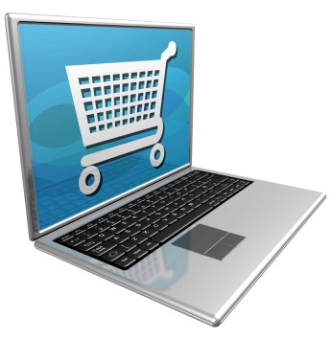



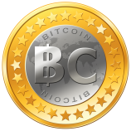

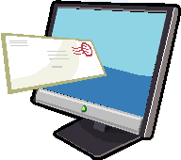
Retail payments innovations and trends 10 internet
Notes:
Online banking, online banking for e/payments, Overlay services, e/billing, virtual currency and pre paid.

Slide 20
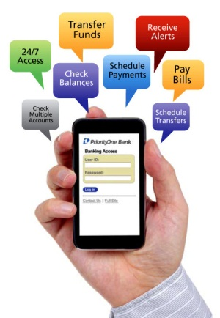
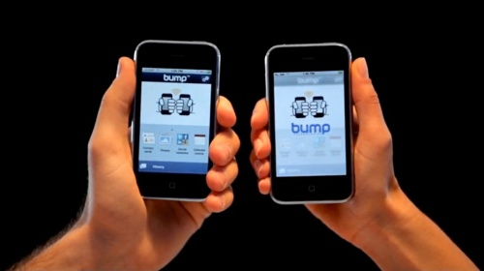
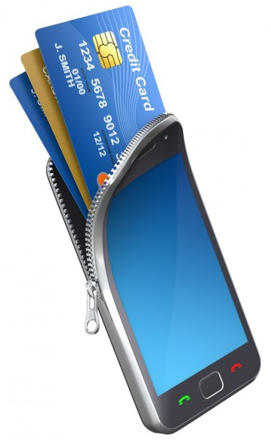
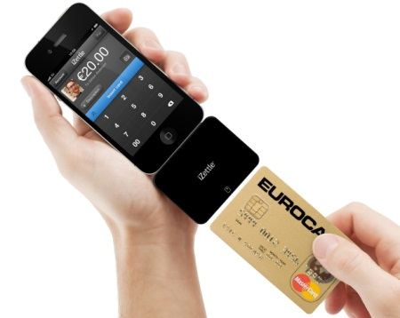
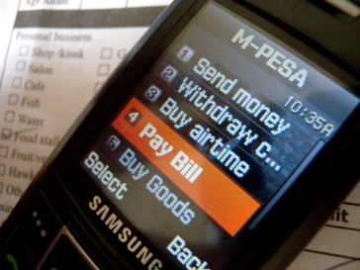
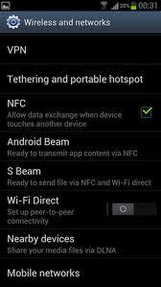

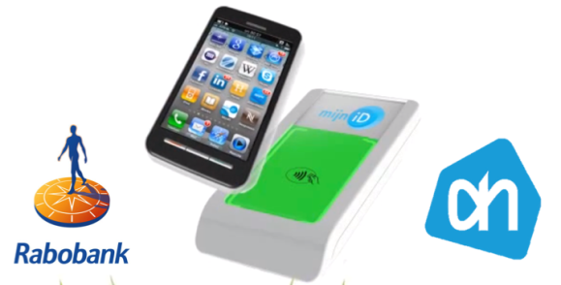
Retail payments innovations and trends 11 mobile
Notes:
P2P via bump, access to e banking, e money account, sms telco bill, NFC at POS via sticker, NFC at POS via phone, mobile terminal

Slide 21
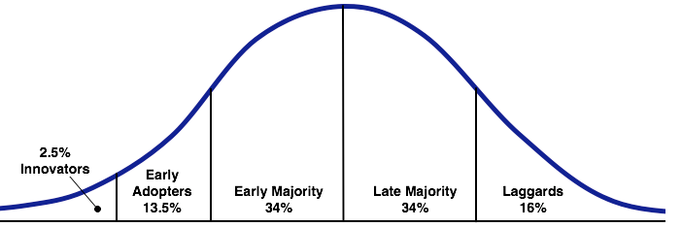
Retail payments innovations and trends 12 mobile
Innovation curve of Rogers
70% has never used mobile payments but…
Based on UK Vocalink report on Mobile Usage 2013
Mobile banking
Smart phones
Mobile payments
Notes:
De Innovatietheorie van Rogers (zoals beschreven in zijn boek Diffusion of Innovations) is een theorie die iets vertelt over de verspreiding van een innovatie (een nieuw product of idee) binnen een groep.

Slide 22
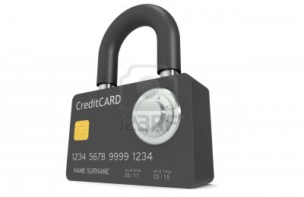
Retail payments innovations and trends 13 security – a common element
Notes:
P2P via bump, access to e banking, e money account, sms telco bill, NFC at POS via sticker, NFC at POS via phone, mobile terminal

Slide 23
Retail payments innovations and trends 14
Why Payment Innovation?
Reduce cash
Promote efficiency
Improve customer loyalty,
New revenue pools
Enhance technological advances
Image building

Slide 24
Retail payments innovations and trends some observations 1
Dynamic market, but classics dominate
Cross-border solutions are rare
Increasing role of pre-paid accounts
Increasing role of non-banks & cooperation

Slide 25
Retail payments innovations and trends some observations 2
Regulatory drivers
Relevance of standardisation
Interoperability – ubiquitous solutions & access

Slide 26


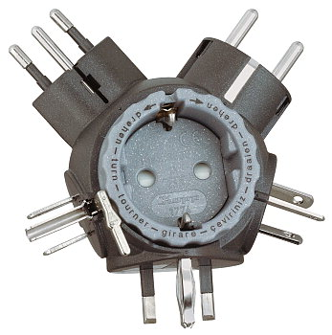


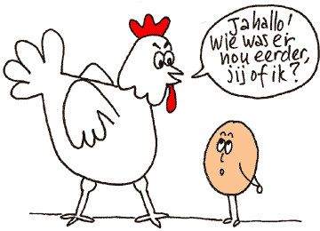
Factors of success

Slide 27
Retail payments innovations and trends 6
Role of DNB and BdP
Catalyst and facilitator of national discussions (e.g. SEPA implementation)
Active contribution in European discussions
Research on the evolution payment habits and underlying explanation

Slide 28

Any Questions

