Slide 1
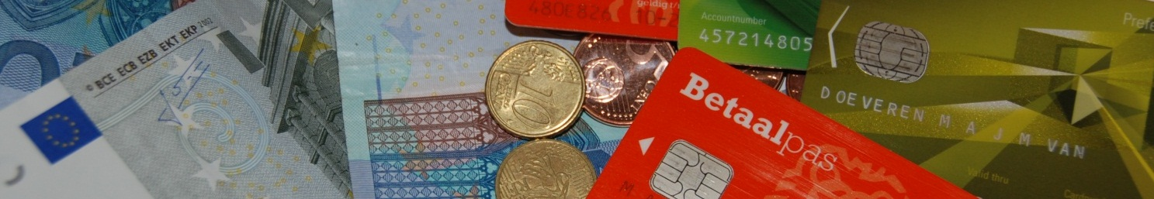

Stakeholders involvement in the National Forum on Payment Systems
Ayse Zoodsma-Sungur and Rui Pimentel
Sixth Macedonian Financial Sector Conference on Payments and Securities Settlement Systems
Ohrid, 1-3 July 2013

Slide 2
Outline
National Forum on the Payment System (NL and PT)
Set-up and procedures
Working Group on Availability and Accessibility
Accessibility Monitor 2010 (Netherlands)
Surveys on SEPA awareness (Portugal)
Final remarks

Slide 3


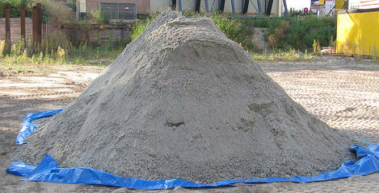
Setting the direction in retail payment needs facilitating a social dialogue between stakeholders
Provide information and tools

Slide 4
WHAT ROLE CAN AUTHORITIES PLAY?
Monitor market developments, provide analyses, including payment statistics, act as catalyst,
Facilitate a social dialogue between stakeholders to:
develop a payments strategy and set work priorities – e.g. SEPA migration
identify harmonisation and standardisation needs
set business requirements for specific payment instruments

Slide 5
National Forum on the Payment System
The National Forum on the Payment System in the Netherlands was set up by the Minister of Finance in 2002 to promote the social efficiency of the Dutch payments system.
broadly based, the Forum represents
→both the providers and the users of payment systems,
including retailers’ and banks’
umbrella organisations like; the consumer interest association disabled people’s organisations, organization for senior citizens
The Forum holds regular consultations on:
→ the social implications of developments in payment systems.
→Its key focus is to establish:
how the payments system can be run more efficiently
for consumers, businesses and banks alike –
Notes:
which is why the Forum brings together players from different ends of the payments spectrum. The MOB does not merely collet and analyse data, it also makes baseline agreements.

Slide 6
Set-up and procedures
The National Forum meets twice a year.
→Its participants represent payment providers and customers.
→The Forum also has three observers;
  Ministry of Economic Affairs, Agriculture and Innovation
Ministry of Finance
Currence
The Forum is chaired by DNB, which also provides secretarial back-up.
→In addition to the core group, the Forum has working groups focusing on particular issues and a special consultative platform.
Notes:
Working Group on Social Efficiency: This working group investigates how social efficiency in the Dutch payments system can be improved also in light of key technological trends. Among the issues addressed are cost structures and the effectiveness of incentives for efficient payment behavior.
Working group on Statistics: This working group’s remit is to systematically compile and publish numerical, non-competitively sensitive data on the Dutch payment system.
Working group on Security: The security working group investigates how to safeguard the security of the payment system and thus help enhance social efficiency. Its remit encompasses both personal security and the security of payment products.

Slide 7
Working groups of the Forum
Availability and Accessibility
Social efficiency
Security

Slide 8
Working Group on Availability and Accessibility
This working group investigates how to safeguard and
improve the physical availability and accessibility
of payments services for consumers and businesses.
Key issue:
How to make sure that all the relevant stakeholders do participate
and have a voice so that there are no accessibility bottlenecks
for payment services.
And it remains Available and accessible for everybody!!
Notes:
The relevant issues are:

Slide 9
Working Group on Availability and Accessibility
Accessibility is about customer friendliness of payment products;
debit cards and payment terminals, internet banking for vision impaired,
using telephone for banking, etc.
Availability is about the actual distances to reach a bank branch to
deposit money or to withdraw money.
The working group conducts researches, participates in projects and try to
contribute with concrete solutions for payments services related topics.

Slide 10
National Forum on the Payment System
In Portugal, the National Forum on the Payment System was set up by Banco de Portugal in 2009 namely as a result of fostering the involvement of main non-bank stakeholders in the SEPA implementation process
The context of intervention of the Forum was defined as a consultative body of Banco de Portugal and complements the activities carried out by CISP – the Interbank Payment Systems Commission, also chaired by Banco de Portugal but in which only the Treasury, the banks and the payments processor take part
In addition, discussions on the social efficiency of the Portuguese payments system have also been developed
Notes:
which is why the Forum brings together players from different ends of the payments spectrum. The MOB does not merely collate and analyse data, it also makes baseline agreements.

Slide 11
Set-up and procedures
The Forum represents both the providers and the users of payment systems, including “big billers” (e.g. electricity, telcos), retailers and Banks, as well as Public Administrations and Consumers associations and has been significantly focused on SEPA migration issues since its creation.
The Forum is chaired by Banco de Portugal, which also provides secretariat
In addition to the plenary, it is established that the Forum can have working groups, and currently there’s a Steering Committee on SEPA issues
Several consultations are performed in written, whenever necessary, using the Forum’s structure
Notes:
Working Group on Social Efficiency: This working group investigates how social efficiency in the Dutch payments system can be improved also in light of key technological trends. Among the issues addressed are cost structures and the effectiveness of incentives for efficient payment behavior.
Working group on Statistics: This working group’s remit is to systematically compile and publish numerical, non-competitively sensitive data on the Dutch payment system.
Working group on Security: The security working group investigates how to safeguard the security of the payment system and thus help enhance social efficiency. Its remit encompasses both personal security and the security of payment products.

Slide 12
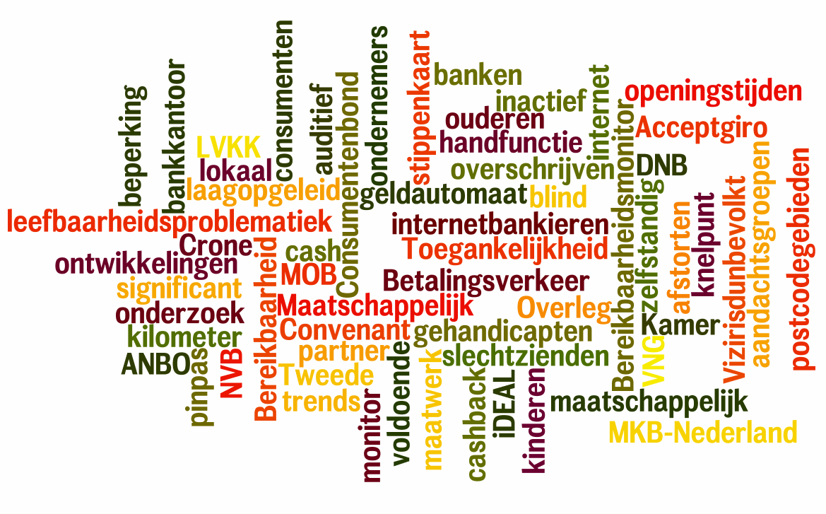
Accessibility Monitor 2010

Slide 13
Accessibility Monitor 2010 (2)
The purpose of the Accessibility Monitor 2010 is to appraise the extent of any generic changes in the accessibility of payment services compared to the 2007 measurement,
and to chart developments and trends as regards the accessibility and usability of payment services.
→Examples of the latter are (automated) substitutes of activities formerly performed at bank branches.
Notes:
In 2006 the Minister of Finance requested the National Forum on the Payment System
(‘the Forum’), the Association of Dutch Municipalities (Vereniging van Nederlandse
Gemeenten, VNG) and the National Association of Small Villages to catalogue
accessibility issues with regard to payment services. The Minister’s request was
prompted by a broadly supported motion brought by Members of the Dutch Parliament
during the debate on the accessibility of basic banking services.

Slide 14
Accessibility Monitor 2013 (3)
Drawing sample
Data collection
Data processing
Via online panel
Paper
questionnaire
DNB
By phone
By phone
Survey compay

Slide 15
Accessibility Monitor 2010 (4)
On the consumer side, the study aims to chart perceptions and experiences regarding the geographical aspects of payment service accessibility, more particularly the locations where services are provided in their relation to the mobility of the consumer.
Also studied were perceptions and experiences regarding the usability aspects of payment services.

Slide 16
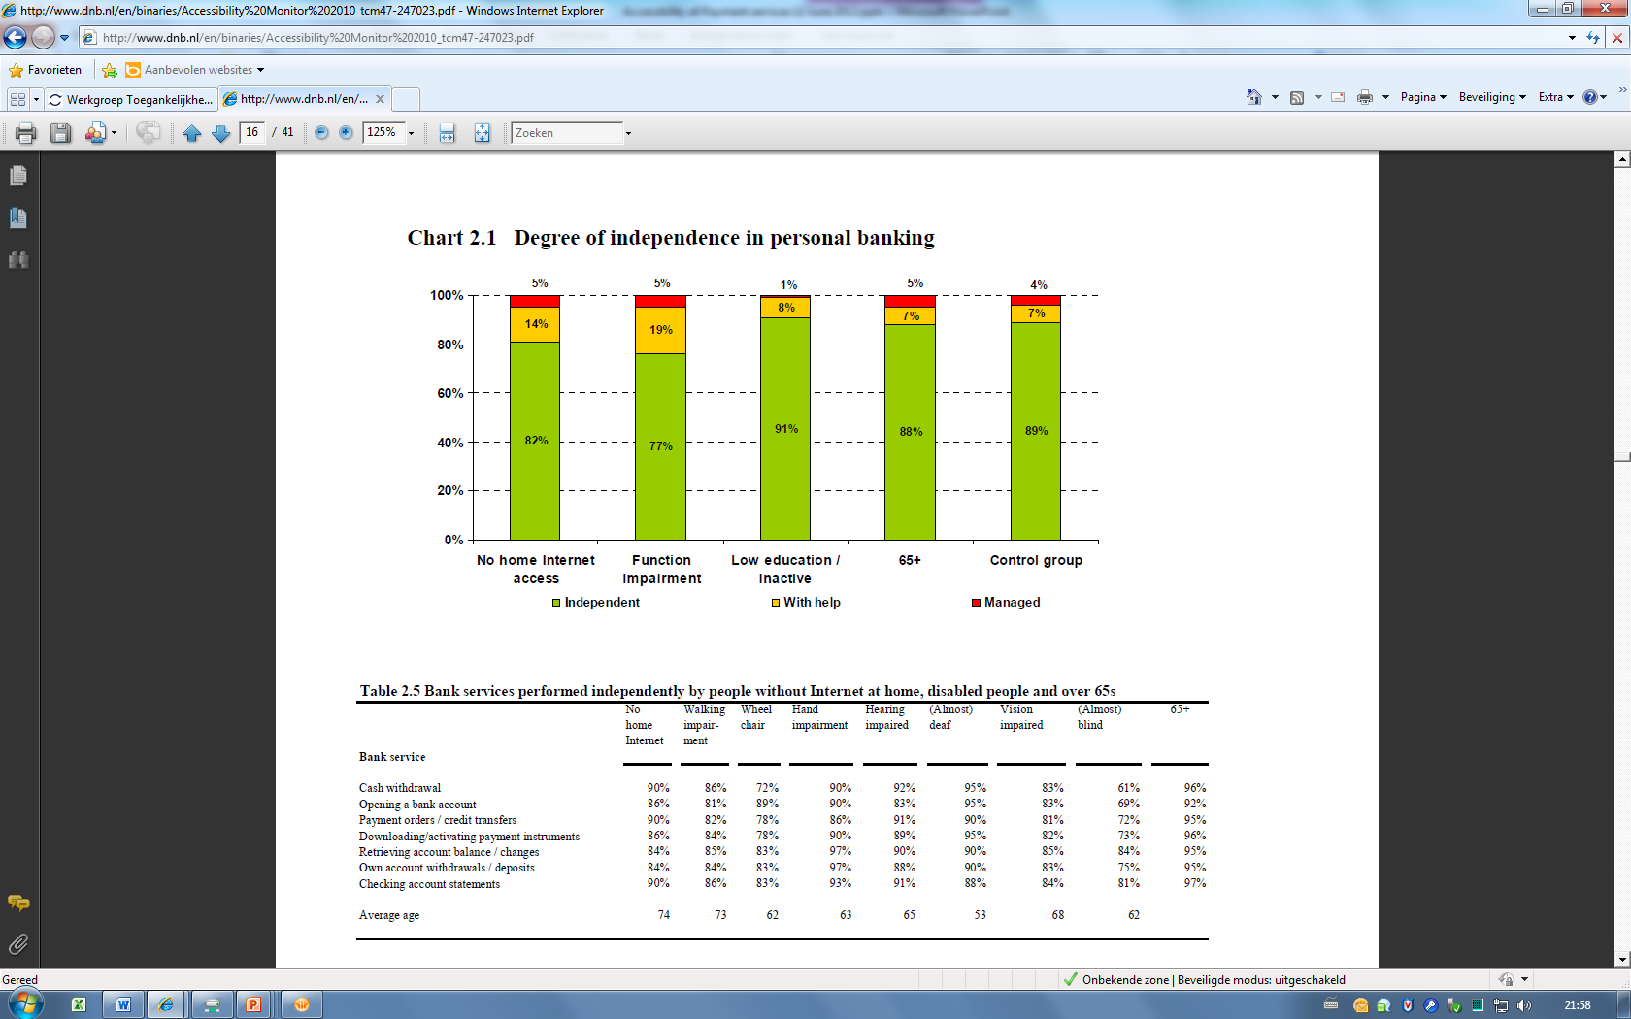
Survey design (9)

Slide 17
Results (1)
The Accessibility Monitor 2010 presents a positive image: there is no evidence of any generic accessibility or usability problem for the Netherlands as a whole.
Consumers and entrepreneurs alike find banking and payment services to be satisfactory.
Consumers, depending on the target group, give average marks of 7.5–8.0 (on a 1–10 scale).

Slide 18
Results (2)
According to consumers, continued attention should be paid to
vulnerable groups in society, such as seniors, the
physicall challenged and those without an Internet connection.
Entrepreneurs’ perceptions of accessibility or lack
thereof tended to centre around cash withdrawals and deposits.
(Opening and closing time of bank branches)
→The number of branches has been in decline since the 1990s.
This trend continued during 2006–2010, with the number of bank branches falling (by an average 2% per year) to under 3,000 by mid-2010.

Slide 19
Results (3)
Offsetting the decline in bank branches
→between 2006 and 2009 was the growth of the number of cash points, POS terminals and cash acceptance machines (CAM).
→Thus the number of locations where bank customers may withdraw cash increased between 2006 and 2010.

Slide 20
Conclusions
The number of bank branches is continuing on its declining trend, while electronic means of payment are increasingly used, at points of sale or over the Internet.
Almost more than 99% of the Dutch population continue to live within
a five km range from a physical payment service facility. …
The continued good overall accessibility of payment services for both consumers and entrepreneurs is due in part to banks’ active commitment on this score and the role DNB takes as a catalyst!!.

Slide 21
Conclusions (2)
According to consumers, continued attention should be paid to vulnerable social groups,
such as →seniors,
→the physically challenged,
→and those without an internet
Entrepreneurs’ perceptions of accessibility or lack thereof tended to concentrate on cash withdrawals and deposits.

Slide 22
FINAL REMARKS
Authorities set the direction by creating basic conditions, organising social dialogue, providing information and tools, imposing security requirements, updating legal framework
Retail banking and payments have high social relevance. Without stakeholder involvement it is not easy to play the designated role of an authority.
Thank you!

Slide 23

Any questions?

