Slide 1


Why are efficient Retail Payments important?
Ayse Zoodsma-Sungur
Sixth Macedonian Financial Sector Conference on Payments and Securities Settlement Systems
Ohrid, 1-3 July 2013

Slide 2
Outline
  Payment patterns around the world
  Concepts & definitions
  How to measure costs?
  The Dutch example
  How to improve efficiency?
  Final remarks

Slide 3
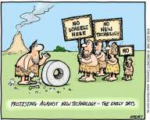
Sense of urgency
Finding the motivation to affect change is very difficult when the existing business model seems to be working well.
But the question to ask is: “Will their zone of comfort force them to wait too long before they make a transition?”
C.K. Prahalad

Slide 4
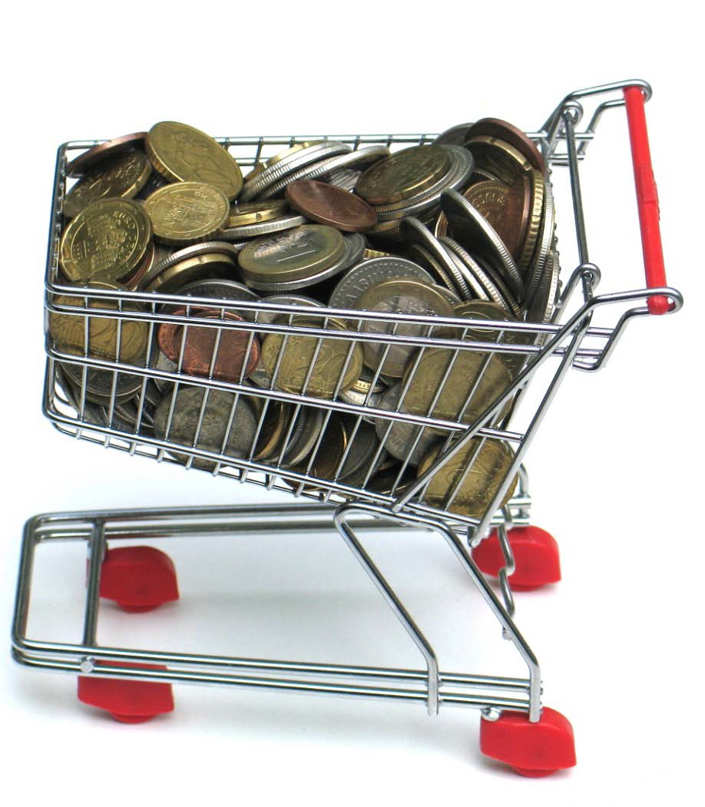
Time to look at trends at the POS- euro area
Is cash still going strong?

Slide 5
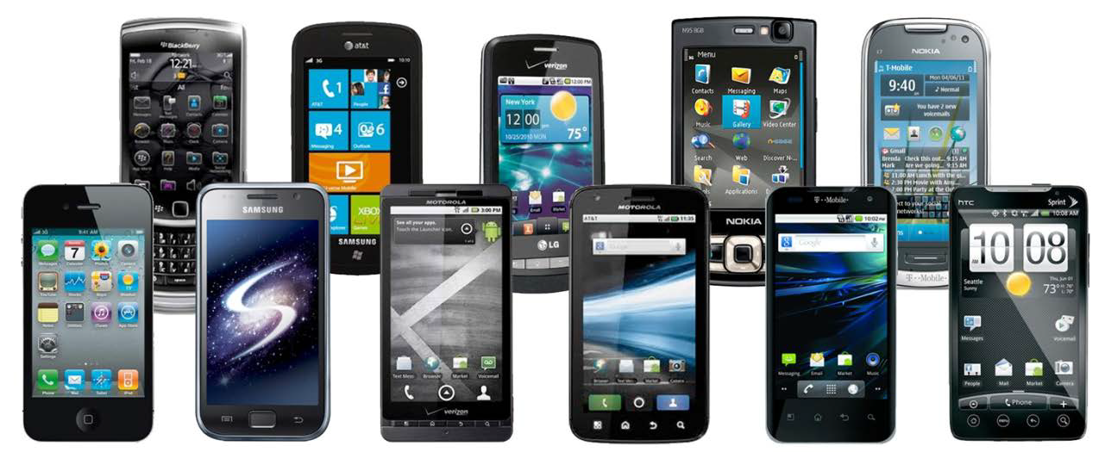
Time to look at trends at the POS- euro area
By the end of 2013, there will be more mobile devices on Earth than people
(Cisco, 2013)
Notes:
By the end of 2013, there will be more mobile devices on Earth than people (Cisco, 2013)

Slide 6
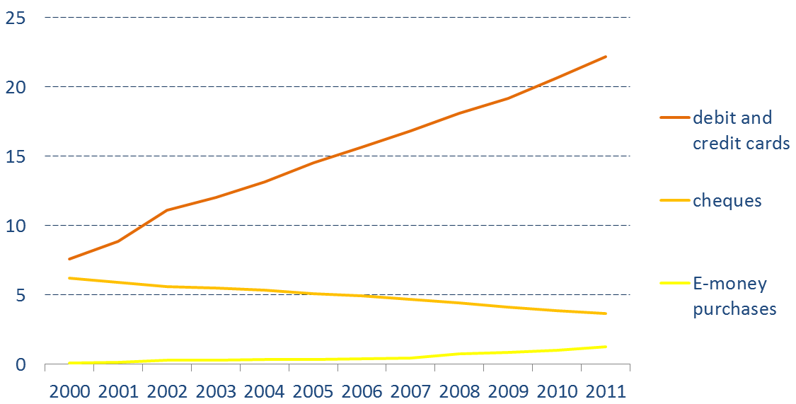
Trends at the POS – euro area
POS payment transactions (billions)
Source: ECB

Slide 7
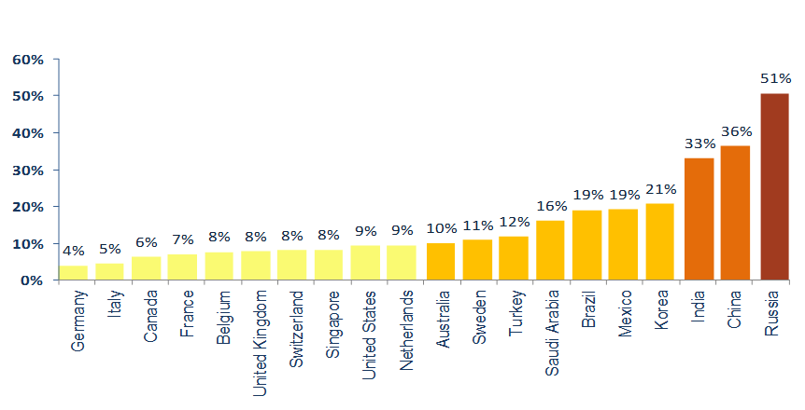
Trends at the POS – world wide
Average yearly growth debit & credit card payments
(2006 – 2011)
Source: BIS, Statistics on payment and settlement systems – figures for 2011 Preliminary release.

Slide 8
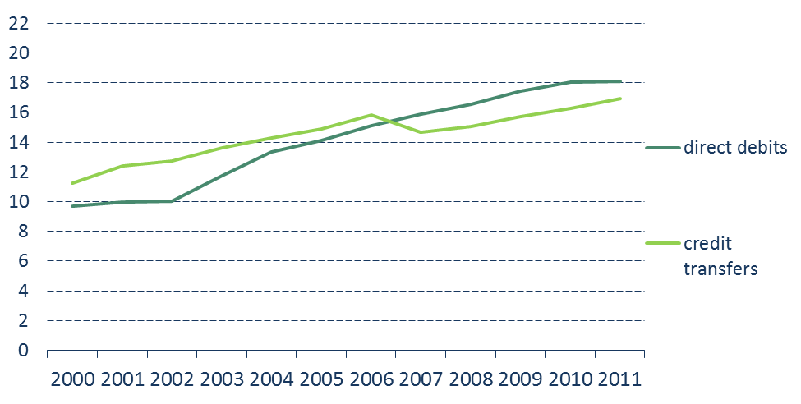
Remote trends – euro area
Remote payment transactions (billions)
Source: ECB

Slide 9
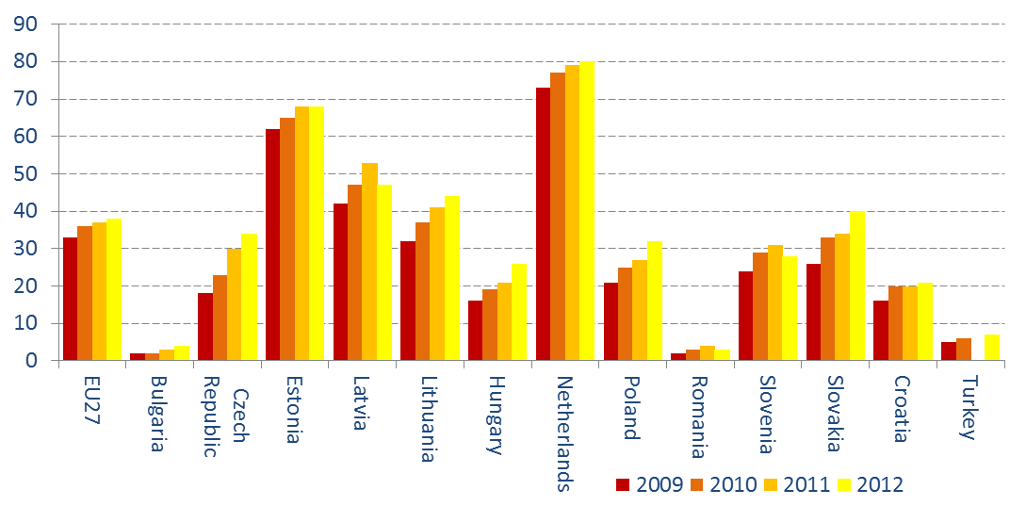
Remote trends – euro area
Percentage of households using internet banking
(Eurostat, Feb. 2013)

Slide 10
Remote trends - NL
Share of paper based funds transfers
Transactions as percentage of total volume
Source: De Nederlandsche Bank

Slide 11
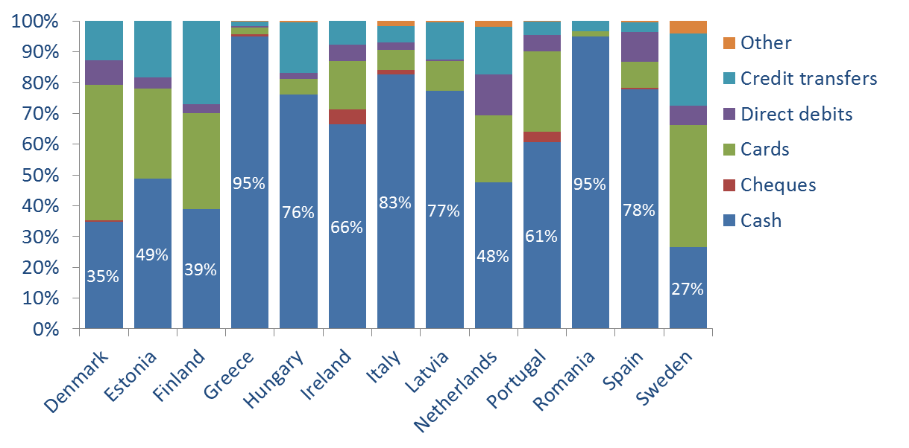
Cash still dominant
Market share of payment instruments (in volume)
Source: ECB Cost Study 2012

Slide 12
Outline
  Payment patterns around the world
  Concepts & definitions
  How to measure costs?
  The Dutch example
  How to improve efficiency?
  Final remarks

Slide 13

Efficiency
  Productive efficiency
  (e.g. reduction of processing costs)
  Allocative efficiency
  (e.g. change payment behaviour)
  Dynamic efficiency
  (e.g. product innovation)

Slide 14
Costs: different concepts
  External costs
  Fees paid
  Internal costs
  Own production costs
  Private costs
  External + internal costs for each party
  Social costs
  Sum of internal costs of all parties
Central bank
Banks
Consumers
Retailers /
Businesses

Slide 15
Outline
  Payment patterns around the world
  Concepts & definitions
  How to measure costs?
  The Dutch example
  How to improve efficiency?
  Final remarks

Slide 16
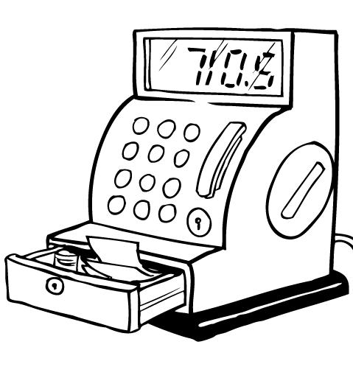
Measuring costs
Step 1:
Estimate total yearly costs per actor per payment instrument:
  fixed and variable
  internal and external
Step 2:
Estimate total yearly volume and value of transactions per payment instrument.
Step 3:
Determine total, internal, external, fixed and variable costs per transaction per payment instrument.

Slide 17
Step 1: Estimate total costs
  Main ingredients of a cost study:
  Determine what payment instruments to look at.
  Determine what parties in the payment chain to include.
  Determine what cost (and revenue) items to include.
  Set up a questionnaire & desk research.
  Distribute questionnaire among representative sample.
  Plus:
  Involve all relevant stakeholders.
  Be realistic about the planning: at least 1 year.
  Decide whether or what to outsource.

Slide 18

What cost items to include?
Costs for (central) banks
Cash
Cash
Debit cards
E-purse
Credit cards
Back office:
Back office:
Back office:
Back office:
Production money
Production cards
Production cards
Production cards
Transportation
Transportation
Transportation
Transportation
Cash centres: staff, buildings, equipment
Telecommunication
Telecommunication
Telecommunication
Fraud & control
Fraud & control
Fraud & control
Fraud & control
Front office:
Front office:
Front office:
Front office:
Branch offices: staff, buildings, equipment
Branch offices: staff, buildings, equipment
Branch offices: staff, buildings, equipment
Branch offices: staff, buildings, equipment
ATM maintenance
ATM maintenance
E-purse charge terminal maintenance
ATM maintenance
Overhead
Overhead
Overhead
Overhead
Armoured car services

Slide 19
What cost items to include?
Revenue for (central) banks
Revenues
Transaction fees
Subscription fees
Balance revenues
Interchange fees
…
…

Slide 20
What cost items to include?
Costs for retailers
Cash
Back office:
Till shortages, fraud
Debit cards
Credit cards
E-purse
Theft insurance
Money purchase
Prepare cash registers
Counting daily receipts
Front office:
Back office:
Back office:
Back office:
Transaction time
Bank fees
Bank fees
Bank fees
Filling /emptying cash register during the day
Fraud
Printing daily overview
Printing daily overview
Printing daily overview
Account keeping
Account keeping
Account keeping
Deposit, storage, transport:
Front office:
Front office:
Front office:
Deposit fees, safe rental
Transaction time
Transaction time
Transaction time
Fees prof. transport
Time own transport
Telecommunication:
Telecommunication:
Telecommunication:
Terminals/devices:
Telecom fees
Telecom fees
Telecom fees
Authentication devices
Terminals/tills:
Terminals/tills:
Terminals/tills:
Depreciation, rental, maintenance tills
Depreciation, rental, maintenance
Depreciation, rental, maintenance
Depreciation, rental, maintenance

Slide 21
What cost items to include?
Revenues for retailers
Revenues
Surcharges
…
…

Slide 22
What cost items to include?
Costs for consumers
Cash
Cash
Debitcards
E-purse
Credit cards
Transaction time
‘shoe leather’
ATM fees
Surcharges
Bank fees
Loss & fraud
…
…
Transaction time
Surcharges
Bank fees
Loss & fraud
…
…
Transaction time
Surcharges
Bank fees
Loss & fraud
…
…
Transaction time
Surcharges
Bank fees
Loss & fraud
…
…

Slide 23
What cost items to include?
Revenue for consumers
Revenues
Loyaltee points
Qualitative benefits:
Speed
Convenience
Safety
Anonimity
Etc…..
…
…

Slide 24
Step 1: Estimate total costs
  Main ingredients of a cost study:
  Determine what payment instruments to look at.
  Determine what parties in the payment chain to include.
  Determine what cost (and revenue) items to include.
  Set up a questionnaire & desk research.
  Distribute questionnaire among representative sample.
  Plus:
  Involve all relevant stakeholders.
  Be realistic about the planning: at least 1 year.
  Decide whether or what to outsource.

Slide 25

Survey: challenges
Response rate:
  How to contact respondents?
  (phone, online, mail)
  User-friendly questionnaire
Reliability of answers:
  Test the questionnaire!
  Try to validate
Aggregation and extrapolation:
  Representativeness of the sample
  Weight factors

Slide 26
Step 1: Estimate total costs
  Main ingredients of a cost study:
  Determine what payment instruments to look at.
  Determine what parties in the payment chain to include.
  Determine what cost (and revenue) items to include.
  Set up a questionnaire & desk research.
  Distribute questionnaire among representative sample.
  Plus:
  Involve all relevant stakeholders.
  Be realistic about the planning: at least 1 year.
  Decide whether or what to outsource.

Slide 27

Stakeholder involvement: why?
Increase commitment of banks and retailers
Agree on purpose and survey set-up
Expertise & know-how
Provide support with survey distribution
General endorsement of survey outcomes

Slide 28
Stakeholder involvement: how?
Regular meetings:
  Multilateral and bilateral
  At different stages of the research
Provision of relevant results

Slide 29
Stakeholder involvement: challenges
Confidentiality:
  Costs & revenues
  Turnover & market share
Resources
What is in it for them?

Slide 30
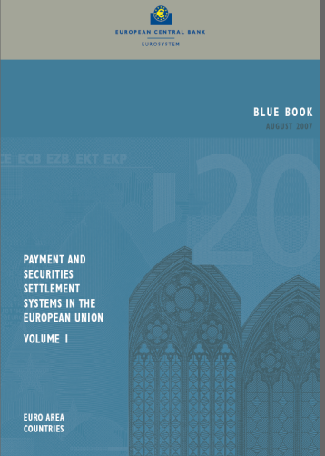
Step 2: Estimate transactions
  Card payments, credit transfers,
  direct debits and other electronic payments:
  Banks
  Payment processor(s)
  Blue Book (ECB)
  Red Book (BIS)
  Cash:
  Not centrally registered
  Occur at a wide variety of places
  Person-to-person (P2P)

Slide 31
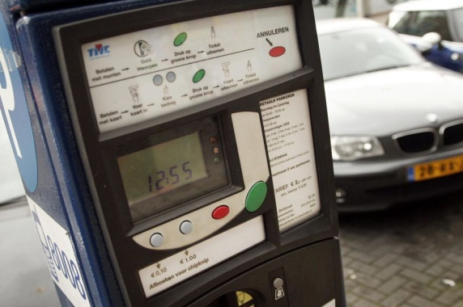
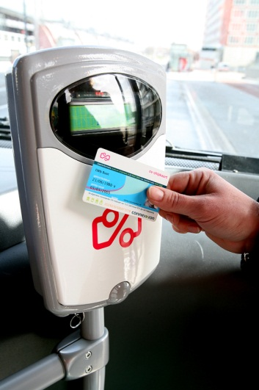

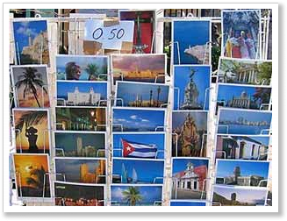
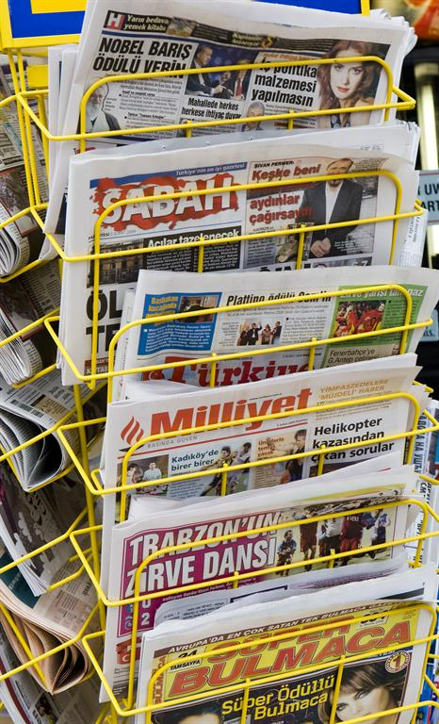
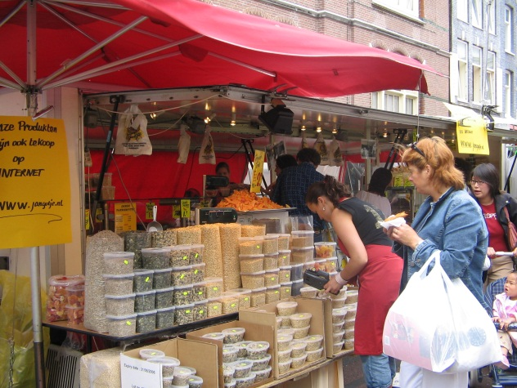
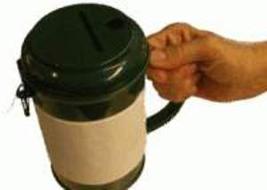
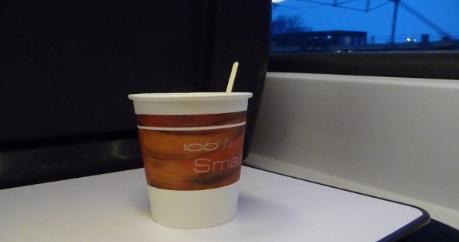
How many cash payments did you make yesterday?
Question:

Slide 32


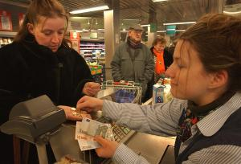
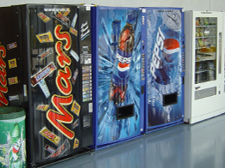

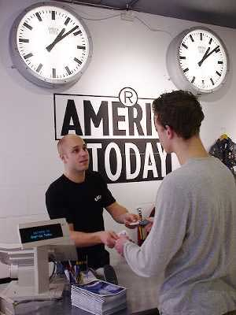
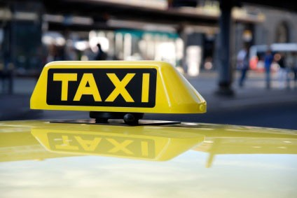
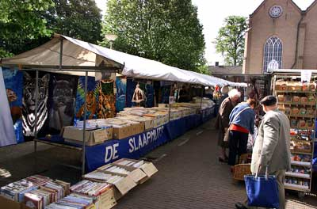


Step 2: Estimate transactions
What is the best methodology to measure
the number of cash payments?

Slide 33

Measuring cash usage
Retailer approach:
+ High number of observations
+ Availability of ‘true’ transaction records
- Difficult to draw representative sample
- Availability of transaction records biased
- Exclusion of P2P transactions
Consumer approach:
+ Inclusion of P2P transactions
+ Less difficult to draw representative sample
- Measurement error
(omission, invention, behavioural change)

Slide 34
Measuring cash usage
Research design matters a lot!
Main challenge: low value transactions
Conclusions DNB research:
  Omission is smallest with 1-day transaction diary
  … and highest with questionnaire, or
  ... 1-week transaction diary
1-day transaction diary

Slide 35
1-day transaction diary

Slide 36
Outline
  Payment patterns around the world
  Concepts & definitions
  How to measure costs?
  The Dutch example
  How to improve efficiency?
  Final remarks

Slide 37
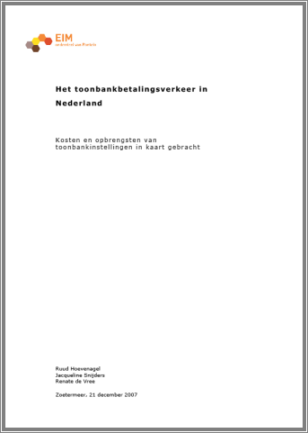
The Dutch experience

Slide 38
Social costs in the Netherlands
Main results 2009
Social costs are substantial:
  Cash 0.31% GDP
  Debit card 0.11% GDP
  EUR 330 per hh per year
Social costs per transaction:
  Cash EUR 0.39
  Debit card EUR 0.32
Break-even point EUR 3.06
Social costs per 10 EUR sales:
  Cash EUR 0.31
  Debit card EUR 0.08
Social costs per 1 additional transaction of 10 EUR:
  Cash EUR 0.23
  Debit card EUR 0.17

Slide 39
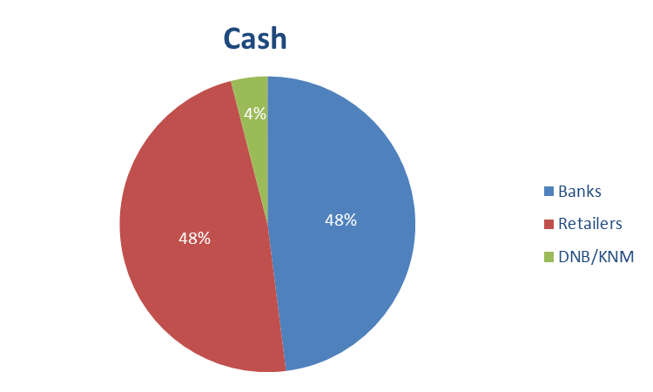
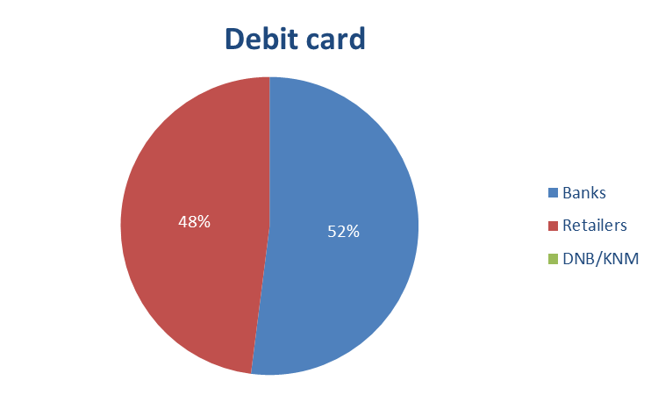
Social costs in the Netherlands
Social costs by agent 2009

Slide 40
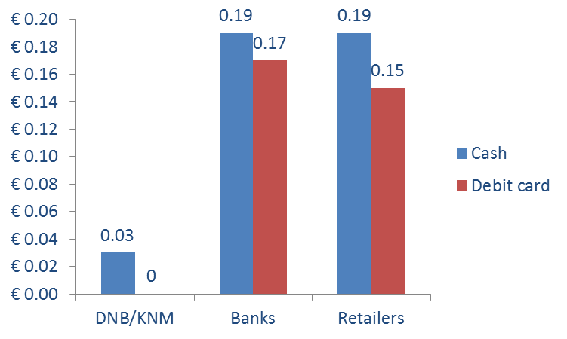
Social costs in the Netherlands
Social costs per transaction by agent 2009

Slide 41
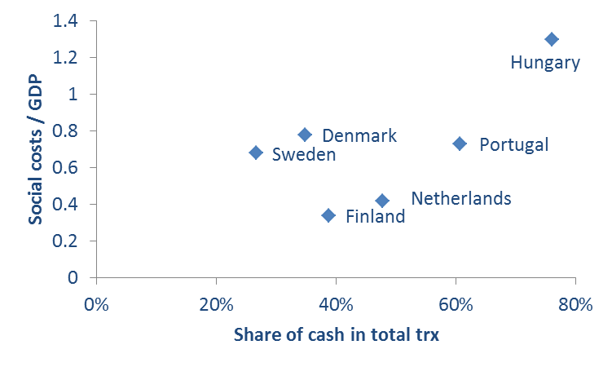
International cost studies
Share of cash & Social costs / GDP
Source: ECB Cost Study 2012

Slide 42
Main policy objective
Substitution paper-based by electronic payments
POS payments: cash → debit card
Remote payments: paper transfers → internet banking, e-invoicing, direct debit

Slide 43
Outline
  Payment patterns around the world
  Concepts & definitions
  How to measure costs?
  The Dutch example
  How to improve efficiency?
  Final remarks

Slide 44
How to stimulate efficiency?
Financial
incentives
Discounts
Loyalties
…
…
…
Transaction fees
Surcharges
…
…
…
Positive
incentives
Negative
incentives
Current account usage
Acceptance
Public campaigns
POS promotion
∆ perceptions
Non - acceptance
…
…
…
Non-financial
incentives

Slide 45
Outline
  Payment patterns around the world
  Concepts & definitions
  How to measure costs?
  The Dutch example
  How to improve efficiency?
  Final remarks

Slide 46
Role of DNB
“Smooth, reliable and efficient payment system”
  Catalyst and facilitator of national discussions
  Active contribution in European discussions
  Research on payment patterns and underlying drivers and barriers

Slide 47
Vision of DNB
Research = important ingredient for further improving the social efficiency of retail payments
We support initiatives to stimulate usage of cost efficient payment instruments, but safety and accessibility should be guaranteed!
LESS CASH rather than CASH-LESS society!

Slide 48

Any questions?

