Slide 1
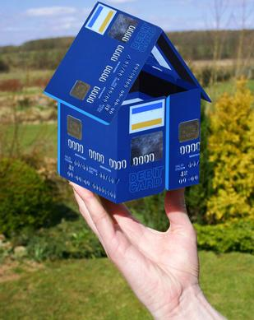

Developments in collateral and liquidity management in Europe
Nynke Doornbos
Macedonian Financial Sector Conference on Payments and Securities Settlement Systems (Ohrid 6)
Ohrid, 2 July 2013

Slide 2


Outline
Rising demand for collateral
Basics Eurosystem collateral framework
Collateral trends
TARGET2 securities

Slide 3
Role of collateral
General
Collateral no purpose in itself
Collateral to mitigate counterparty risk
Eurosystem:
Protection against losses (monetary operations and TARGET2 payment capacity
‘All credit operations should be collateralised’ (ESCB Statute, Article 18.1)

Slide 4
Collateral techniques: Repo, Pledge, Earmarking and Pooling
Repo:
Pledge:
Earmarking
Pooling:
buy and sell back operation (legal transferof title)
transfer of securities or loans (economic transfer)
collateral marked for a specific credit operation
collateral, deposited in a pool (several uses)

Slide 5
General developments – more demand for collateral
Less unsecured lending, collapse unsecured money market
The need for high quality collateral is growing, regulators impose capital and liquidity ratio’s on banks (Basel3: B3-LCR and B3-NSFR)
Collateral needed for derivatives transactions, for securities lending, for repo-market and ECB refinancing operations
Result: more asset encumbrance

Slide 6
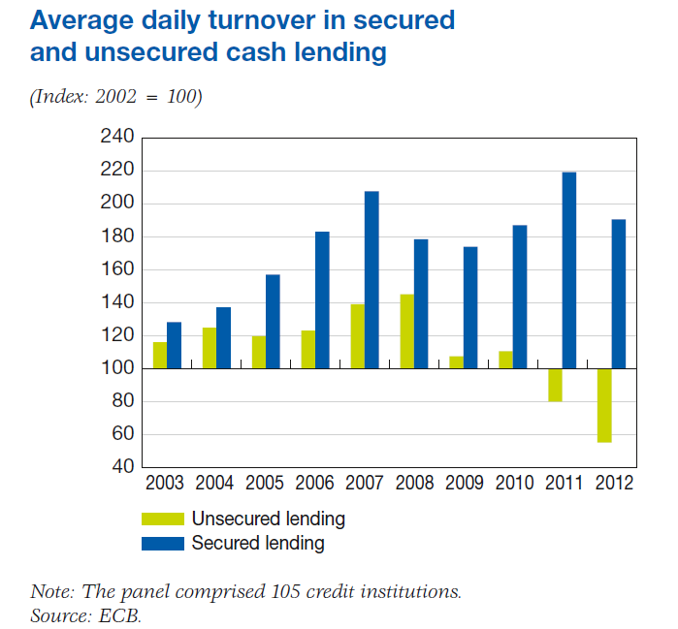
Collapse unsecured money market
Collateral needed for secured lending

Slide 7
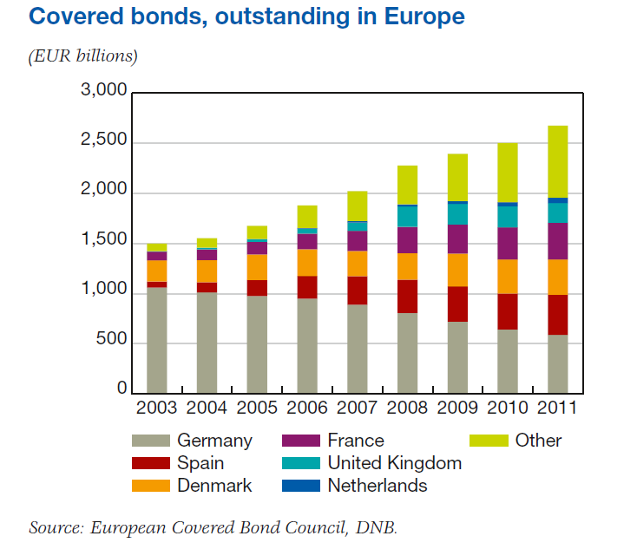
Example of secured funding: covered bank bond
Other example of secured funding:
Asset backed securities

Slide 8
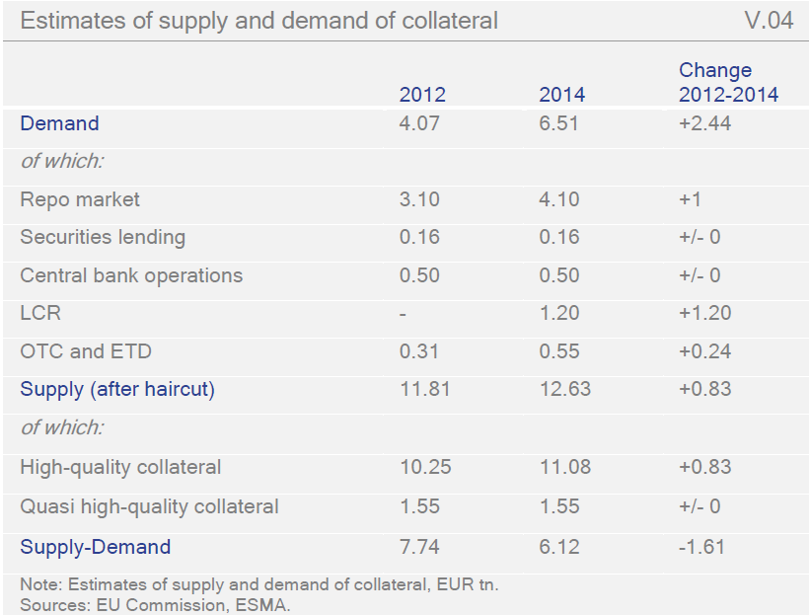

Slide 9
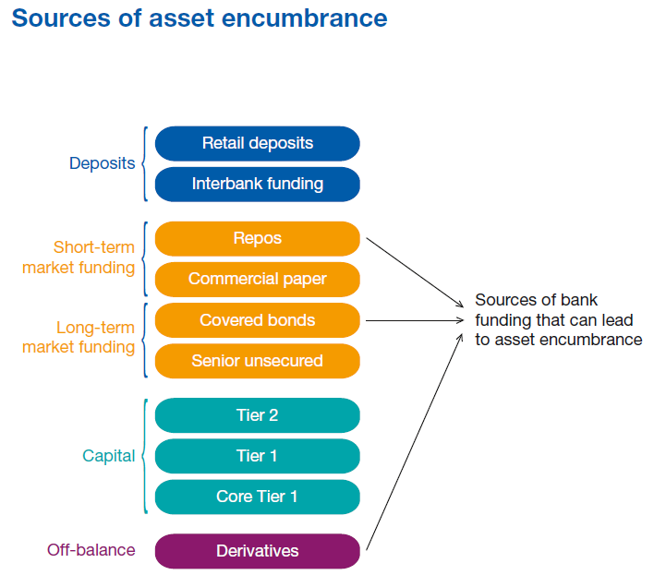
Encumbrance
Bank pledges assets to creditors to limit their loss given default; the assets pledged for this purpose are encumbered
Higher asset encumbrance leads to higher funding costs
Transparency on asset encumbrance needed

Slide 10
Outline
Rising demand for collateral
Basics Eurosystem collateral framework
Collateral trends
TARGET2 securities

Slide 11
Use of collateral for Eurosystem Central bank functions
Monetary policy implementation -> lending to commercial banks
Smooth functioning of public payment system (TARGET2) by providing intraday credit (a bank can have a negative balance based on the amount of deposited collateral)

Slide 12
Other local uses of collateral by central banks
Banknote obligations (held by banks, but legally owned by Central Bank)
Clearing-and margin funds obligations for securities settlement (Clearing members of Central Counterparties (CCPs) must comply with clearing and margin fund obligations. This requirement can be met through a Central Bank guarantee, based on collateral)
Third Party Assignment (Counterparties can block their own collateral to provide credit in TARGET2 to subsidiaries or other third parties in favour of third-party TARGET2 accounts)
CLS (Banks that facilitate payments through CLS are required to cushion this service by freezing collateral)

Slide 13


10 key principles of the Eurosystem Collateral Framework (ECF) - I
Collateral security
Protect the Eurosystem from losses.
The volume of available collateral must ensure that the Eurosystem
  can effectively conduct monetary policy operations
  promote the smooth operation of the payment system.
Eurosystem operations should be accessible to a broad set of counterparties.
Offer cost-efficient transfer and mobilization conditions, credit risk evaluation and monitoring possibilities.
Be in accordance with the principle of an open market economy with free competition, favoring an efficient allocation of resources.

Slide 14
10 key principles of ECF- II
Be simple and transparent.
Be flexible enough to meet future funding/liquidity crises.
No special or privileged treatment of public sector securities.
Market neutrality principles (=avoid unintended market distortions).
Keep the operational burden acceptable.

Slide 15
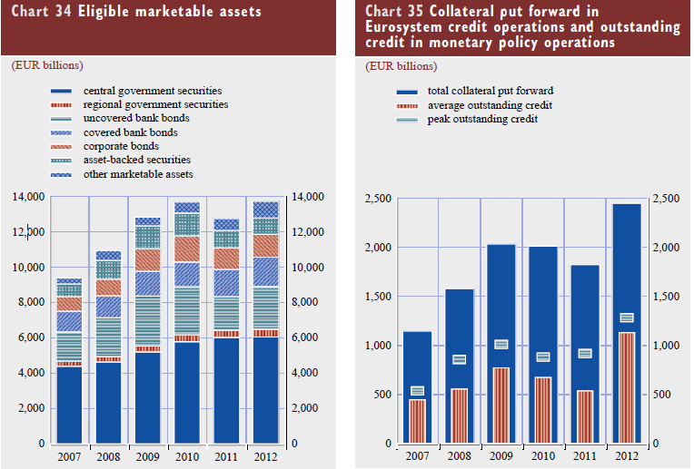
Sufficient collateral?
Conclusion?
  Eligible in 2012: +/- EUR 13,600 bln
  Deposited collateral in 2012:
  +/- EUR 2,440 bln
  Use: +/- EUR 1,590 bln

Slide 16
Current topic in the eurozone
Finding a balance: collateral availability and risk protection
    Collateral availability
    (Widen collateral)
      ensure banks’ funding buffers
      support lending to real economy
      support particular markets? (e.g. ABS)
      prevent pro-cyclicality
    Risk protection
    (Restrict Collateral)
      limit direct risk taking
      prevent moral hazard
      transparency and harmonisation

Slide 17
Basics Eurosystem collateral framework
Rule based framework:
uniform -> single list of collateral
harmonised risk control framework
Discretionary measures:
When needed for risk protection
Also on level individual counterparties
Consistent, transparent and non-discriminatory

Slide 18
The Eurosystem framework: Basics
All liquidity providing credit operations of the Eurosystem based on adequate collateral (no cash)
One collateral-list for monetary policy purposes and payment system operations and local use, with loss sharing among NCBs, separate list for non-loss sharing collateral
Broad collateral list consisting of marketable and non-marketable assets (broad definitions)
Lending to financially sound counterparties
Credit provided by Home Central Bank

Slide 19
Broad eurozone collateral framework – examples eligible assets
Marketable assets (securities)
Non marketable assets
Government bonds
Bank bonds (unsecured)
Corporate bonds
Covered bonds
Asset Backed Securities
Credit claims (bankloans)
Weekly fixed term deposits at the Eurosystem
Irish mortgage backed promissory notes

Slide 20
Risk control framework
Three types of protection:
Eligibility of collateral (collateral should be adequate, wide or narrow framework)
Risk control measures (examples: haircut, concentration limits)
Financial soundness of counterparties (acceptance criteria and balance ratio’s)

Slide 21
Outline
Rising demand for collateral
Basics Eurosystem collateral framework
Collateral trends
TARGET2 securities

Slide 22
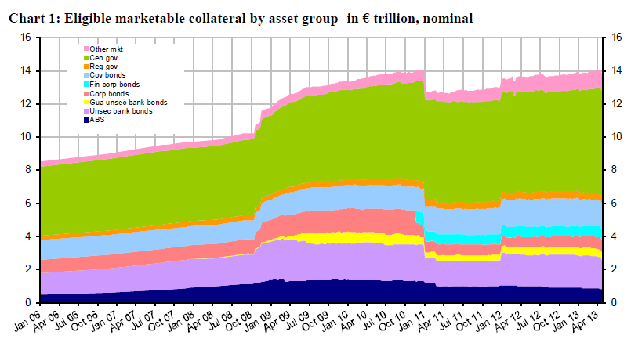
Eligible collateral by asset type – EUR trillion, nominal value
Snapshot date 29 May 2013

Slide 23
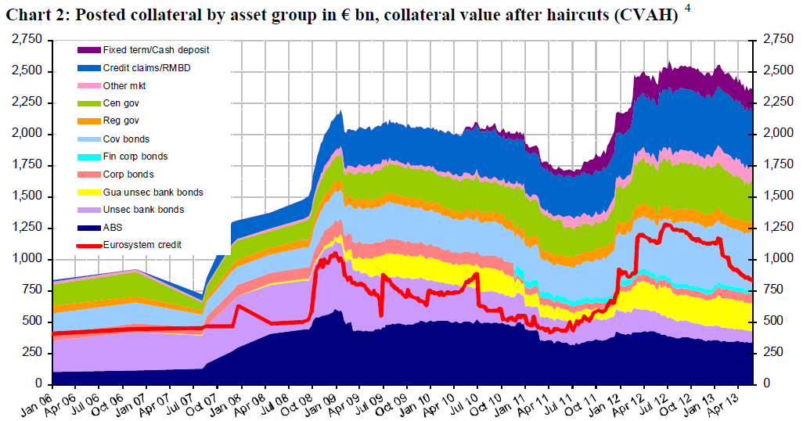
Use of collateral for credit operations
Posted collateral by asset group – EUR billion, Collateral value after haircuts
Snapshot date 29 May 2013

Slide 24
Agenda
The Eurosystem collateral framework
European collateral trends
Impact of turmoil on financial markets
Crossborder mobilisation of collateral

Slide 25

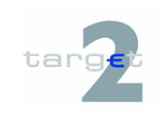



Collateral mobilisation flow today
(domestic and cross-border)
Release of Credit
Bank
Country A
Release of Credit
Cash account
Bank in Country A
NCB
Country A
Confirmation
Mobilisation instruction
Mobilisation instruction
NCB
Country B
CCBM
message
Delivery
of collateral
instruction
Settlement
confirmation
Matching
Confirmation
CSD A
Central
Securities
Depository
Matching
CSD B
Central
Securities
Depository
Delivery of collateral instruction

Slide 26

Development: Triparty Collateral Management
Third party (e.g. (I)CSD) acts as an agent for the taker (Eurosystem)
and provider (counterparty) of the collateral.
Taker and provider enter into an agreement with triparty agent on
the level of outsourcing.
Triparty
Triparty
agent
Triparty
agent
Triparty
agent
agent
(I)CSD
(I)CSD
(I)CSD
Contractual
(I)CSD
Contractual
Contractual
Contractual
relationship
relationship
relationship
relationship
CMS
counterparty
counterparty
counterparty
counterparty
joining
NCB
Contractual
NCB
Contractual
relationship
relationship
Triparty
arrangement with CCBM2 (domestic dimension)

Slide 27
Basics Triparty Collateral Management
Typically for repo transactions, securities lending, or securities pledged to a central bank
Triparty service providers offer generic collateral management services: collateral eligibility checks, valuation, optimisation, automatic allocation and substitution, monitoring and reporting
Collateral takers: central banks, commercial banks, supranationals, state agencies, asset managers
Collateral givers: broker dealers, commercial banks, asset managers, investment banks

Slide 28

Triparty Collateral Management
The flow between provider(s) and user(s)
National Central Bank
Country A
Bank
Country
A
Bank
Country
A
National Central Bank
Country A
Bank
Country
A
National Central Bank
Country A
(Request for in- or decrease credit line)
Request for in- or decrease credit line
(Matching)
Release (decrease) of credit line
Triparty
agent
Confirmation

Slide 29
Current status Eurosystem Triparty
Triparty solutions currently in use with NCBs:
  Clearstream Banking Frankfurt (XemaC)
  Clearstream Bank Luxemburg (CmaX)
  Euroclear Group (Autoselect)
Domestic level only
Models vary to certain extent, in particular in relation to messaging (i.e. NCB connection)
In 2014 available for all eurozone counterparties (also crossborder)

Slide 30
Developments in securities settlement
Roles in the securities chain
Barriers to integration in Europe
TARGET2 Securities project

Slide 31
Securities chain
Agreement to exchange securities for cash
Trading
Clearing
Calculation of mutual obligations
Delivery of securities and payment of cash
Settlement

Slide 32
Traditional roles in Securities Markets
EXCHANGE
LISTING
TRADING
CCP
CLEARING
CLEARING
HOUSE
CSD
CENTRALBANK
SETTLEMENT
CASH
CLEARING
ISSUER
CSD
INVESTOR
CSD
BANK &
BROKER
INVESTOR
ISSUER

Slide 33
Role of Central Banks
Services in CentralBankMoney (CeBM)
  Cash settlement in TARGET2
  Collateral Management for CCPs (NL, BE)
  And in the future . . . . . . . . . . .TARGET2Securities (Pan- European platform for settlement of trades in CentralBankMoney, 2015-2017)
Oversight
  Financial stability – limit systemic risk
  Limit losses of participants
  Limit contagion to other markets
  Enhance confidence in payment systems

Slide 34
European Developments
Importance of clearing and settlement of those trades for smooth functioning of the financial system: inefficiencies have serious consequences . . . . .
European Union has identified 15 barriers for integration (Giovannini 2001 - updates):
  Technical and operational barriers, market based(10)
  Legal and fiscal barriers (5)

Slide 35
What is the status of integration…
Too high settlement costs
- EU domestic costs range from
0.35 to 3.43 €;
- … and are higher than US
(+ 0.10 to 2.90 €);
- Cross-border costs higher than
domestic ones (19.5 to 35.0 €).
Source: Oxera, LSE, CEPS

Slide 36
Integration models in Europe
Horizontal integration
Vertical integration
Euroclear (ICSD)
CIK (BE)
Deutsche
Börse
Euroclear (FR)
Euroclear (NL)
CBISSO (IE)
Crest (UK)
Eurex
Clearing
Euroclear
Clearstream

Slide 37

Infrastructures EU
Euronext
Amsterdam + Brussels + Lisbon + Paris
Euronext
Amsterdam + Brussels + Lisbon + Paris
London Stock Exchange
Borsa Italia
na
Deut
sche Borse
Luxembourg Stock Ex
change
Oslo Bors OM Nasdaq HEX
Bolsa y Merc. Esp.
GPW
Trading
LCH.Clearnet Group ltd
Clearnet SA
LCH
CC&G
Eurex Clea
ring
Clearing
Settlement securities
Euro
clear Neder
land
Euro
clear België
Euro
clear France
Crest Co
Monte Titoli
Clearstream BF
Clearstream BL
VPS
Nordic CSD
Iber
clear
KDPW
CRBS
Settlement cash
DNB
NBB
BdF
BOE
Banca d´
Italia
Bundesbank
BCL
Nordic central banks
Banca d´ Espana
Bk of Poland
TARGET2

Slide 38
Where do we stand?
Negative:
Fragmentation and complexity remains
No European passport, so a regulatory mess
Positive:
+ Increased competition
+ Breaking down monopolies
+ Significant reduction in tariffs (in the Netherlands clearing cost went from 0.65 eurocent to 0.05 eurocent per trade)

Slide 39
Consequences for Central Banks
Services in Central Bank Money
  Cash settlement also for MTF’s and new CCP’s – national silo´s disappear
  Collateral Management for new CCP’s
Oversight- monitor stability risks:
  New CCP’s and their settlement agents
  Increased complexity
  Interoperability
  Rely on foreign regulators, supervisors and overseers (MiFID art 34 and 46)

Slide 40
Settlement models
Interfaced settlement model
Transaction are settled using an interface between the Payment System (RTGS) and the Securities Settlement System (SSS)
The security-leg is settled in the SSS while the cash leg is settled in the RTGS

Slide 41
Settlement models
Integrated settlement model
Cash to be transferred into the Securities Settlement System in order to enable real-time DvP in the SSS
or
Securities to be transferred into the RTGS in order to enable real-time DvP in the RTGS

Slide 42

What is TARGET2Securities?
An integrated settlement platform of the Eurosystem for the DVP settlement of securities transactions in central bank money within the euro area :
- All securities which have to be transferred
- Cash needed for settlement
Supports the integration of the securities settlement market infrastructure
Making cross-border transactions domestic ones in the Eurozone
The extension to other currencies is an option

Slide 43
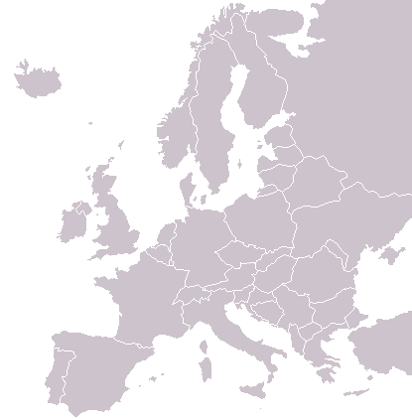
Why T2S
TARGET2Securities? A workable solution for Cross-border settlement of securities in Euroland: DVP in Central Bank Money
APK
Euroclear Group
Deutsche Börse Gruppe
Euroclear NL
Clearstream FraM
NBB Clearing
Clearstream Lux.
Euroclear BE
OeKB
Euroclear FR
Monte Titoli
BOGS
Interbolsa
Iberclear

Slide 44
Why T2S?
  Making cross-border-settlement fees as inexpensive as domestic fees (volume dependent and economies of scale)
  Reducing users’ collateral and liquidity needs and funding costs through a single pool of securities and CentralBankMoney
  Harmonising settlement to make Europe a Single Market,
  Financial stability

Slide 45
Background: Essential concepts
T2S concerns only settlement in CEntralBankMoney (CeBM)
CSD
NCB
Custodian Bank or ICSD
CentralBankMoney
CeBM
Commercial BankMoney
CoBM
Investor Bank
Investor

Slide 46
How?
A single IT-platform
CSD’s outsource the administration of securities accounts to T2S
Credit institutions transfer cash to T2S through DCA-accounts: real-time DVP!
During the day, but also at the end of the day, information about settled securities return to the CSD’s and the money goes back into TARGET2
Custody- and notary-functions remain at the CSD’s (added value services)

Slide 47
TARGET2 Securities (during the operating hours)
CSD-V
CSD-VI
CDS-VII
CSD-VIII
CSD-IV
EuroClear
The Netherlands
TARGET2 - Securities
Dedicated cash accounts
Securities accounts
CSD-III
EuroClear France
DVP
TARGET2
CSD-II
Cash accounts
Clearstream
Banking
Frankfurt
etc.
CSD-I

Slide 48
The T2S User Requirements
  Scope of assets
    All types of securities which CSD’s are settling today (debt instruments, equities, investment funds, warrants)
  Scope of services
    Whole life cycle of a transaction: receiving settlement instructions, providing matching facilities, verifying
    availablity of securities and CeBM etc
Notes:
(real time liquidity transfers between T2 RTGS accounts and T2S sub cash accounts will be possible automatically and on demand)

Slide 49
Benefits T2S
Fosters competition among CSD’s
Reduces intermediary costs
Reduces collateral needs and costs
Reduces back-office costs
Facilitates cross border business with easier and cheaper cross-CSD settlement

Slide 50
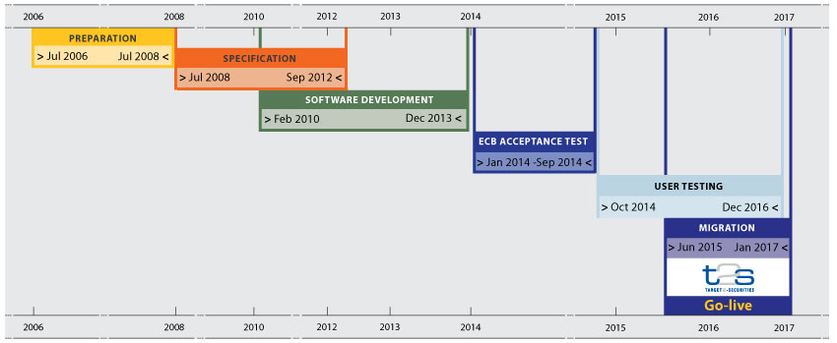
Programme plan
Notes:
June 2015: Go-live operational phase: start of implementation in three waves, one contigency wave, max 4 waves in 18 months, 3 months between 2 waves. Contingency wave within 6 months after third wave, end: april 2017

Slide 51
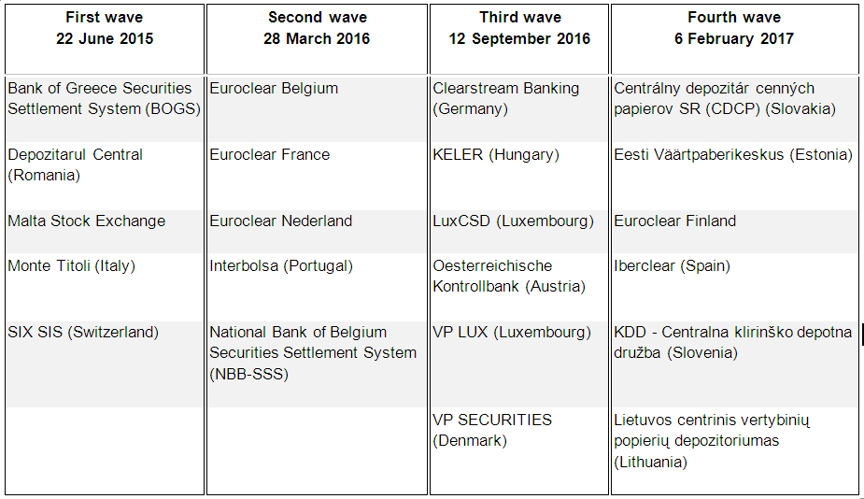
Migration waves

Slide 52
Eurosystem Collateral Framework
True or false
Only intraday operations should be collateralised
A credit balance can be used as cover for Monetary Policy Operations
The principles behind the framework have been decided in 1999

Slide 53
Eurosystem Collateral Framework
True or false
Only supervised Banks and Pensionfunds are allowed to take part in monetary policy operations
It is the European Central Bank who decides which collateral is eligible
Ireland and Spain are 2 countries who make use of pool-pledge
The Eurosystem adjust their framework in case of a crisis

Slide 54
Eurosystem Collateral Framework
True or false
CCBM was the answer of commercial banks on the request of the ECB to facilitate X-border use of collateral
TriParty Collateral Management is the answer from ICSDs on several requests of the banks to promote X-border use of collateral

Slide 55
Questions
What is the difference between pool/pledge and repo/earmarking?
What, from the perspective of a Central Bank, is cheaper: pool/pledge or repo/earmarking?
And what about the perspective of a Commercial Bank?
Why did Central Banks develop CCBM?
What is attractive in TriPartyRepo?

Slide 56
Questions ??
Thank you !!

