Slide 1


New Developments on SEPA Implementation
8th Conference on Payment and Securities Settlement Systems, Ohrid, 11-13 May 2015
Michiel van Doeveren and Rui Pimentel

Slide 2
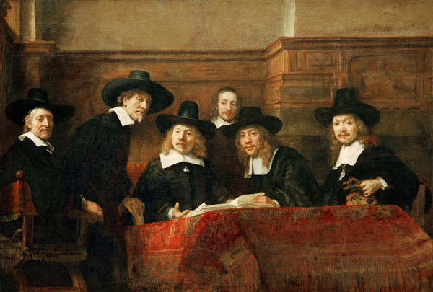
Rembrandt: De Staalmeesters 1662

Slide 3
Agenda
What is Single Euro Payments Area (SEPA)
SEPA products
SEPA migration
Communication on SEPA & Retail Payments
Concluding remarks

Slide 4

What is SEPA?
One single market for euro retail payments in 34 countries

Slide 5
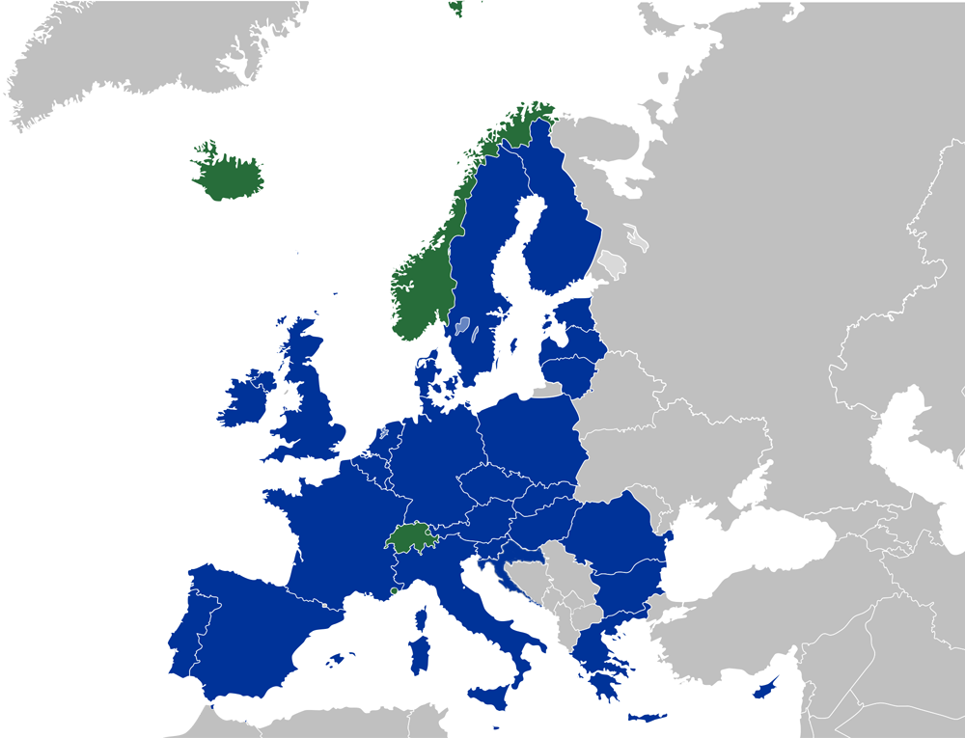
Goal of SEPA: an integrated euro payments market
34 SEPA-countries
523 million citizens
4,500 payment service providers
A single set of payment instruments in euro
Efficient infrastructures for the processing of euro payments
Common technical standards
A harmonised legal basis

Slide 6
European Payments Market
2013 | NL | PT | Euro area | EU
Inhabitants (mio) | 16.8 | 10.5 | 334 | 508
GDP (Eur bio) | 603 | 166 | 9,589 | 13,069
Payment Service Providers | 267 | 350 | 6,258 | 9,079
Transactions (mio) | 6,070 | 1,801 | 67,691 | 100,014
ATM’s (ths) | 7.4 | 16.1 | 309.7 | 434.8
Cards (mio) | 30.5 | 19.8 | 477.0 | 738.4
Source: ECB
Notes:
6

Slide 7
SEPA, what is it?
Political vision
One internal “domestic” market for euro retail payments, generating economies of scale and promoting competition in a 34-country region but with no borders in the performance of retail payments
Aim
Consumers and businesses will be able to make and receive payments in euro within Europe under the same basic conditions, rights and obligations, regardless of their location
(i.e. all transactions become “domestic”)
Concretely
European payment instruments for both cross-border and domestic payments in euro: credit transfers, direct debit and cards. This also means the end of domestic legacy payment instruments.

Slide 8

Long term benefits of SEPA
Efficiency and competition lead to cost optimisation and benefits for society as a whole
Reduction of fees for average user of payment services in Europe
Increased ease of use
Fostering innovation at European scale

Slide 9
SEPA, how?
Self-regulation by European banks in the European Payments Council:
  Common technical rules and standards for euro payments in Europe
Harmonisation of relevant European legislation:
  Payment Services Directive for euro and non-euro payments
  End date(s) for national legacy payment instruments
As a result: SEPA Regulations EU 260/2012 and 248/2014

Slide 10
SEPA migration rates (euro area)

Slide 11
IBAN
IBAN : International Bank Account Number
Administrator of national IBAN registers (ISO): SWIFT
Country
code (ISO)
Check
digit
Bank identifier
Domestic account
number
The bank identifier is country-specific (ISO standard)
The length of the bank identifier differs from country to country
Each country has its own Basic Bank Account Number system
The Netherlands has an 18-digit IBAN; In Portugal IBANs have 25 characters
Bank customers are getting accustomed to using IBAN

Slide 12
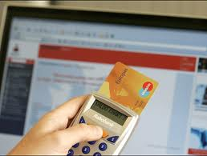
SEPA Credit Transfer
EPC interbank standard for credit transfers in euro – introduced in 2008
Main features
  Payments are made for the full original amount
  IBAN (and BIC)
  ISO 20022 UNIFI standards
  Up to 140 characters of remittance information are delivered to beneficiary
  Unstructured or structured remittance information as agreed between the parties involved
End dates
  1 August 2014 for euro countries
  31 October 2016 for non-euro countries

Slide 13

SEPA Direct Debit
EPC interbank standard for direct debits in euro – introduced in 2009
Main characteristics
  Payments are made for full original amount
  IBAN (and BIC – until 1 Feb 2016)
  ISO 20022 UNIFI standards
  One-off or recurrent
  A mandate is signed by debtor (option for e-mandate)
  Pre-notification (14 calendar days in advance)
  Refunds (PSD: 8 weeks) and returns
End dates
  1 August 2014 for the euro area, 31 October 2016 for non-euro countries
  No domestic MIF after 1 February 2017

Slide 14




Information flows and choice of channel
Basis: business-to-consumer relationship with business as initiator
Business delivers payment instructions to bank and receives reports back
Customer’s choice of channel driven by various considerations:
  Timing: carefully determine when instructions are executed and fast account reporting;
  Functionality: payment products and XML-based formats (from back office) as desired;
  Completeness: correct reference information in instructions (end-to-end) and reports (for automated reconciliation);
  Secure: payment files cannot be manipulated.
Clearing & Settlement
Report
Report
Payment instruction

Slide 15
Channels
Banks offer their customers various channels for exchanging payment/collection instructions and account information
Choice of channel depends in part on customer profile (retail, wholesale), products used and transaction volumes
Main channels
Paper
Internet banking
Client application
Bulk channel

Slide 16
File formats will change under SEPA
Current situation: national formats for payment instructions and reporting (adjusted to local features & habits)
Additional information in SEPA messages, does not fit current formats:
  IBAN (SCT, SDD)
  Creditor scheme identifier (SDD)
  Mandate information (SDD)
Therefore, change to ISO 20022 XML for SEPA products:
  Payment instructions: mandatory via PAIN messages
  Reporting: CAMT messages (not mandatory)
Banks’ own reporting formats permitted provided they meet SEPA requirements

Slide 17
National Forum on SEPA Migration (NFS)
National Forum on SEPA Migration (NFS)
High-level consultations
All stakeholders involved
Focus on cross-sectoral migration issues
Information exchange and agreements between stakeholders
Activities in the areas of:
  Communication
  Migration planning
  Monitoring
  Identifying and resolving societal migration issues
      (similarly in Portugal)
Task Force SEPA Netherlands
Programme Agency
Umbrella organisations
Providers
Users
Software suppliers
Supporting parties
Individual
parties

Slide 18
SEPA Migration Monitor
Policy measurement at the national level
Aim: insight into the status of SEPA migration of
corporates, public authorities and software suppliers
Four dimensions:
1. Awareness of the meaning and implications of SEPA
  Stage of preparations
  Actual use of SEPA payment instruments
  Development of software packages
Notes:
18

Slide 19
Migration monitor results (SMEs)

Slide 20
SEPA Communication
Campaign
To improve knowledge on IBAN and products
Three stage rocket:
- General public campaign
- Umbrella organisations with members
- Enterprises & organisations with clients
Timing: milestones
Notes:
This week we will announce which of the 5 bureau who presented their approach is the winner. The campaign will be developed during the first quarter of 2011 and start just before the first “big movers” like UWV and SVB, this will create a soft landing. First attention to compagnies, give consumers supporting information around milestones. Using all kind of media, payd and unpaid. Also close monitoring of the social media and active influencing opinions when there is an active discussion regarding SEPA, IBAN, enz.
This is a different approach than other countries are using (this afternoon you get more information about other countries).
Consumers; Never heart about IBAN just over 50%. Women and peope older than 55 never heard about IBAN
Sepa is known by almost 40%
23% is positive, around 13% is negative, 13% no meaning and the rest, around 55% neutral
Three stage rocket means;
Public campaign to inform Netherland, create a soft landing and start the awareness and the migration
Umbrella organizations are informing their members
Compagnies informing their customers and clients (cascade model)
AIMS
Why IBAN, where to find
Neutral position
Active use of IBAN, avoid questions
Enterprises&organisations know what to do, are neutral and start to migrate

Slide 21
Communication Goals
Knowledge:
  Consumers got th know where they can find IBANs
  Firms know what measures they have to take to migrate to SEPA
Attitude:
  Neutral attitude towards IBAN usage & SEPA migration
Behaviour:
  Consumers use the IBAN
  Firms were prepared for the SEPA change-over

Slide 22
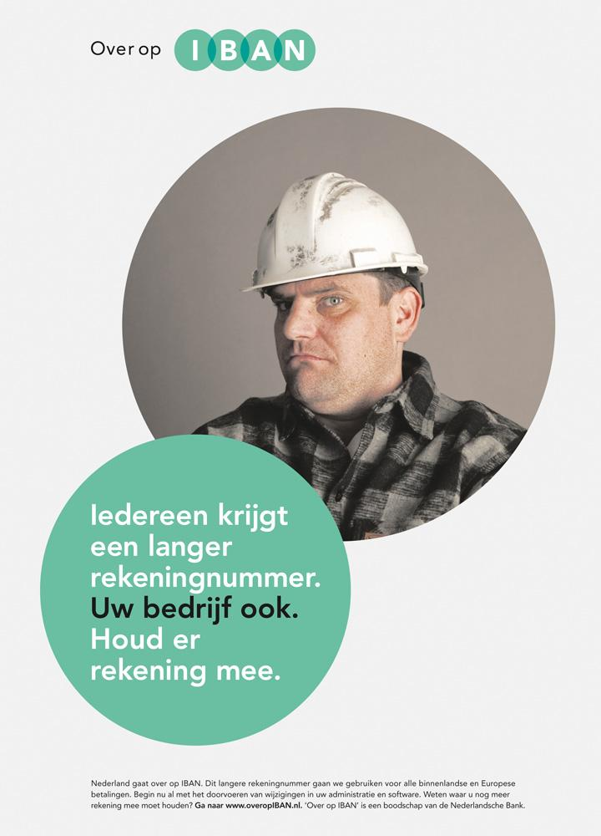
SEPA Communication
Netherlands
Informing consumers about IBAN: a final mass media campaign was held in June-July 2014
Call to action for businesses: increase in presentations, seminars, publications
Close cooperation between DNB SEPA Programme Office and stakeholders
Website: www.overopIBAN.nl

Slide 23
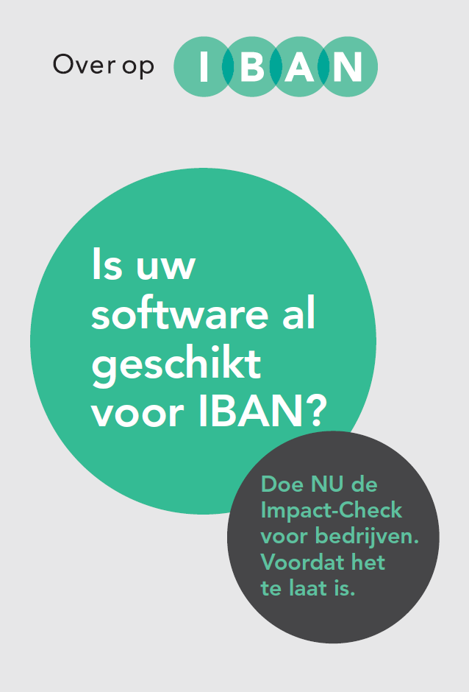
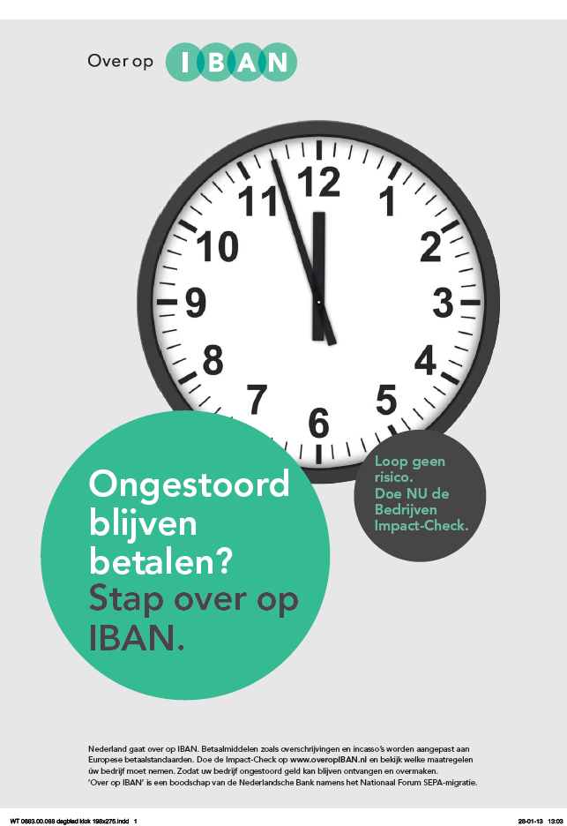

Slide 24

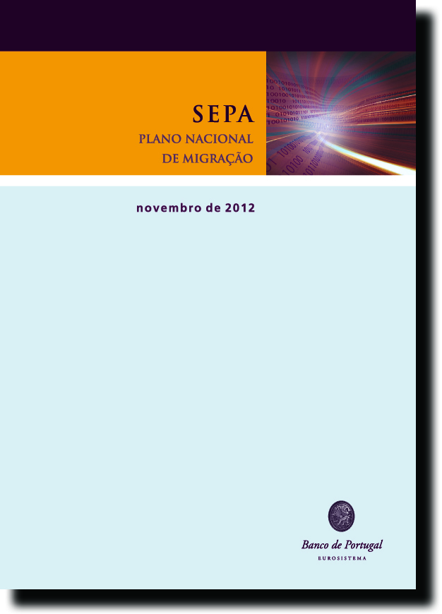
SEPA Communication
Portugal
Spreading information among end-users consumers about the changes needed and how they had to adapt and operate in the future
Banco de Portugal took a leading role, partnering with banks and other relevant entities
Focus on Public Sector and businesses: national migration plan, presentations, Q&A, etc
Seminars throughout the country in Summer 2013

Slide 25


Concluding remarks
The success of SEPA 2.0 depends on:
A full implementation of the SEPA-Regulation
The finalisation of Payment Services Directive 2 and the Regulation on Interchange Fees in 2014/2015
Well organised governance model: the Euro Retail Payments Board started its work in May 2014
Further European standardisation and innovation
Focus on SEPA for Cards as the “third pillar” of the European retail payments market integration

Slide 26

Discussion points
Thank you!
What are the advantages (and consequences) of SEPA for different market players?
What are possible barriers for the migration to SEPA for market players?
How could SEPA governance be enhanced on an European and national level?
What could be the next wave of SEPA products?
What would be the conditions for a stabilised market, fully SEPA-compliant?
What role is needed from central banks in communication to end-users?
How could countries outside Europe profit from SEPA?

