Slide 1
Government Payments in the Netherlands and Portugal
9th Conference on Payments and Securities Settlement Systems, Ohrid, 5-8 June 2016
Michiel van Doeveren and Rui Pimentel

Slide 2
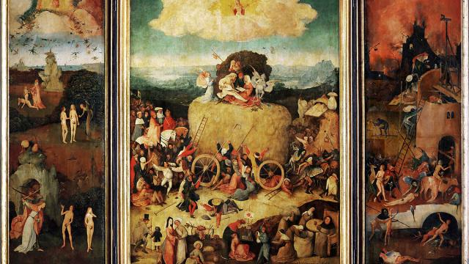
Jheronimus Bosch The Haywain triptych 1502

Slide 3
Overview
Role of central banks
Goverment Payments in the Netherlands
Government Payments in Portugal
Conclusions

Slide 4
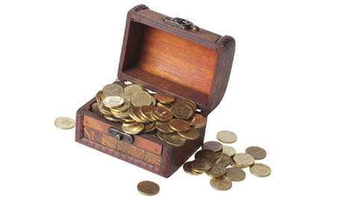
Public sector – NL
Central government/ministries
Lower governments: regional bodies and local communities
Tax Authorities
G4-partners (SVB, UWV, CJIB and DUO)
Other independent organisations

Slide 5
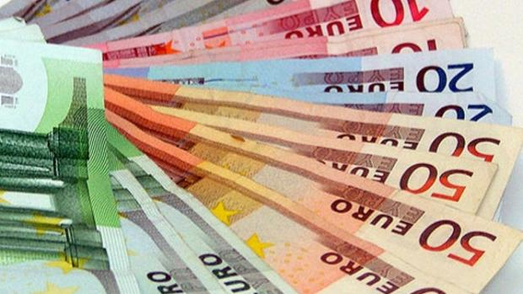
Public sector Payments in the Netherlands
Money market operations
Commercial banks are implementing public sector payments
Tender procedure for selecting a new home bank
ING is responsible for the central government payments for the period 1 May 2016-30 April 2020
Treasury banking

Slide 6
Expenditures of government payments
Salaries of civil servants
Social expenditures
Other current expenditures
Investments

Slide 7
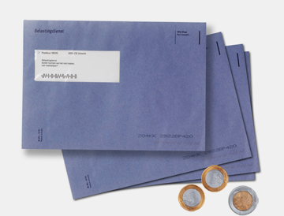
Governement collections
Tax collections
Profits (Gas earnings)
Participations in State firms
Public sector payments
Other

Slide 8
Treasury banking
Obliged for government bodies after the collapse of Ice Save and the financial crisis in 2007-2008
Participation in the treasury without market risks
Less risks, more effective cash management
Less borrowings by the central government
Lower level of EMU-debt (advantage is 2%)

Slide 9
Public sector – PT
Central government/ministries, incl. Tax Authority
Regional governments (islands) and local communities (municipalities)
Role of the Treasury
Social Security

Slide 10
Public sector Payments in Portugal
The State Treasury participates in the clearing system
It ensures payments execution for the vast majority of public bodies (e.g. Tax Authority, etc)
The Social Security is an exception

Slide 11
Expenditures of government payments
Salaries of civil servants
Other current expenditures
Investments
Social Security opens tenders to have sponsoring banks for a given period
Other entities work with the Treasury

Slide 12
Conclusions
Government payments are rather sophisticated and efficiently organised
Commercial banks are implementing the government payments in the Netherlands
In Portugal the system is mixed for overall payments ordered by the government

